Slide 1
Security Protocol Project
Cristian Daniele & Erik Poll
Digital Security
Radboud University Nijmegen

Slide 2
This course: form
Lectures & some reading material
Group project to design, build and document a JavaCard smartcard application
in groups of 4 students
Grade based on group project
Form groups of 4 persons asap !

Slide 3
Learning objectives
Experience the whole process from high-level design, given security requirements and assumptions, down to actual code on real hardware
Appreciate complexity & interplay of
design considerations & constraints,
key management & distribution,
protocols,
low level implementation details,
silly hardware limitations, weird crypto padding, ...
practicalities of getting all of this working
How to document this whole process

Slide 4
Prerequisites
Very basic knowledge of (a)symmetric crypto:
hashing
using (a)symmetric crypto for encrypting, signing, MACing
the use of certificates with asymmetric crypto
Knowledge of basic security concepts such as CIA

Slide 5
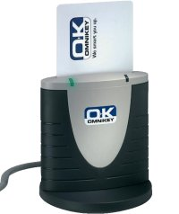
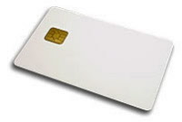
Group project
You have been contracted to build a system
electronic purse
loyalty card
petrol rationing
car rental
swimming pool card
that uses a smartcard
So you must
design security protocols for this smartcard to interact with terminals,
think about keys, certificates, PIN codes, etc. this requires,
implement all this
with only bare-bones implementation of the terminals & back-end

Slide 6
Design constraints
you must use a JavaCard smartcard
which can (securely) execute code and store data, incl. use of PIN codes & standard (a)symmetric crypto (eg AES and RSA)
you must store some modifiable info on the card
not just fixed crypto keys but also eg. card balance, credits, logs, counters, …
so that some terminals can operate offline (maybe temporarily)
In our increasingly online world, a solution where cards only store keys for authentication and everything happens online in a central back-end makes perfect sense, but for this assignment it is not allowed.

Slide 7
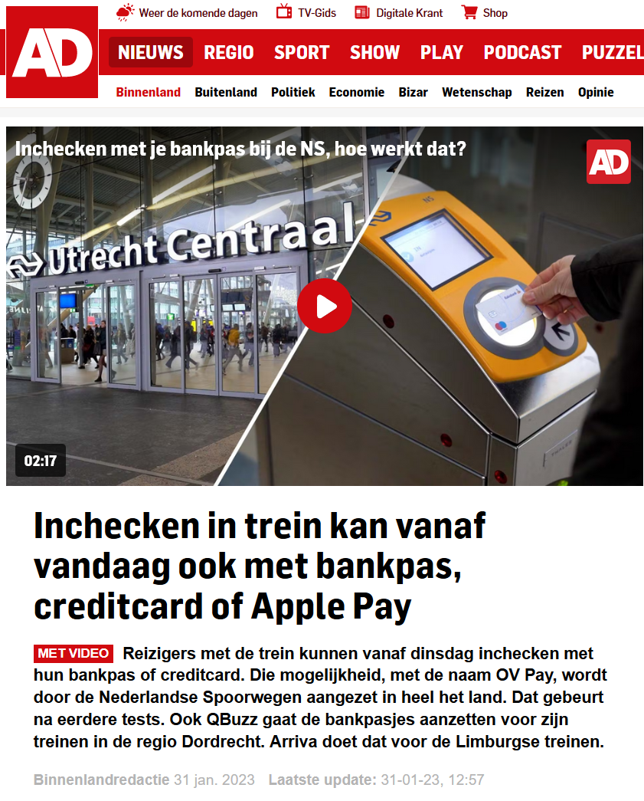
Exit smartcards in a few years?
Or do they simply re-appear as TEEs in smartphones?

Slide 8
Smartcard basics (more details later)
A smartcard is simply a tiny, low-power computer
few KB of RAM (aka volatile memory)
a bit more EEPROM (aka persistent memory) that acts as SSD/hard drive
very low-bandwidth communication, with messages usually just a few dozen bytes
It can execute arbitrary code and store arbitrary data,
e.g. a card number, customer ID, cryptographic keys, certificates, PIN codes, counters, JPEGs, …

Slide 9
Smartcard basics (more details later)
A smartcard is secure and tamper-resistant computer, i.e.
Data & software on the card cannot be read or modified, so card ensures
integrity of the software
also confidentiality of the software
confidentiality & integrity of all data
Installing code on the card is tightly controlled and usually disabled before the card is issued.

Slide 10
Smartcard attack basics (more details later)
Attackers can always do
Man-in-the-Middle attacks on communication between the card & the terminal
card tear attacks by removing the card from the terminal & its power supply
Special case of MitM attack: it abruptly aborts the program executing on the card and wipes the RAM memory content.
and may be able to do
side-channel attacks
eg. analysing power consumption to retrieve cryptographic keys
So you should make sure that different cards use different keys.
Lots more about side-channel attacks in ‘Physical Attacks on Secure Systems’ (NWI-IMC068) & ‘Selected topics on hardware for security’ (NWI-IMC065) by Lejla Batina & Ileana Buhan.

Slide 11
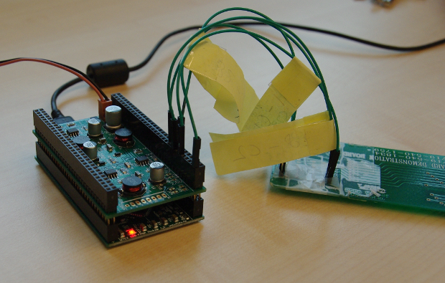
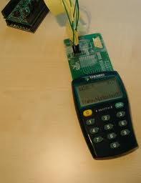
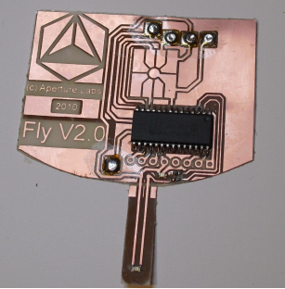
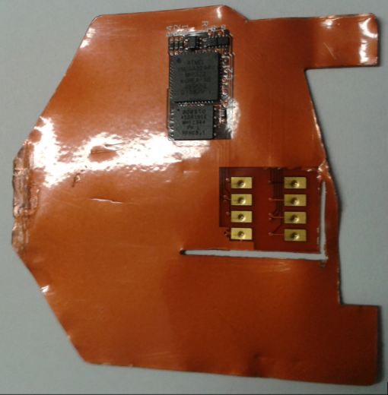
Man-in-the-Middle attacks using shims
Smartlogic tool by Gerhard de Koning Gans
Commercial shim
Shim found inside an ATM
https://krebsonsecurity.com/tag/atm-shimming/

Slide 12
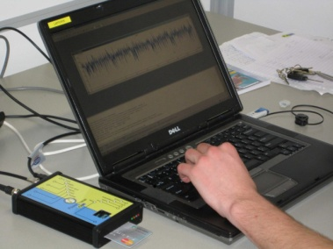
Side-channel attacks
Using side-channel analysis attacker may be able to extract a key from the smartcard so you should not have the same key in all cards
Topic of course “Physical Attacks on Secure Systems”

Slide 13
1st step: write a high level design document
Concise & clear document that outlines and motivates your design
including security requirements, threat / attacker model, trust assumptions, design decisions
down to details like
key & certificate distribution
abstract security protocols
as MSC or in Alice-> Bob style
with clearly stated security goals (eg. authentication, non-repudiation, …)
use of PIN codes or not,
which info gets logged, …
8 pages max, but try to use less
Target audience: security professional that has to assess the security of the proposed system (so no silly marketing blurb)
More info in Brightspace & coming lectures.

Slide 14
Attacker model & trust assumptions
Your attacker model must include
active Man-in-the-Middle attacks on all communications between cards & terminals
card tear attacks
side channel attacks to extract keys from individual card
W.r.t. your trust assumptions :
the software on the smartcard will be in the TCB
you may also need to trust terminals and employees (and maybe even customers?) for some specific properties.
NB even if you cannot prevent some attack by a component or actor, you may be able to detect it.

Slide 15
Use cases: personalisation, issuance & end-of-life?
Cards need to be personalised
installing software, initialising keys, PIN codes, IDs, names, ...
before it is issued to the user (aka card holder)
This will typically require a separate (trusted) terminal.
In addition to say point-of-sale terminal.
Personalisation may happen in several stages.
Cards may also need to be disabled, eg. at the end-of-life?
Or still be able to report data for fraud investigations?
Be explicit about the life-cycle of the card, eg with a state diagram

Slide 16
Persistent life cycle state
Card always has to record some life cycle state
This state has to be recorded & maintained in persistent memory (ie EEPROM)
Your report MUST include a state machine like this!
initial
personalised
issued
blocked
end-of-life

Slide 17
Getting started
Next week: more discussion of the design document & any questions you may have
Deadline for the initial design document: Feb 21.
But the sooner you hand it in, the better.
Lots more info in Brightspace.

