Slide 1
Smartcard protocols
ISO 7816
Erik Poll
Digital Security
Radboud University Nijmegen

Slide 2
Standard for contact smartcards ISO7816
7816-1 Physical characteristics
7816-2 Dimension & size of contacts
7816-3 Electronic signals and transmission protocols
  defines voltage & current requirements
7816-4 Inter-industry commands
  standard set of commands
7816-5 Numbering system for application identifiers (AIDs)
7816-6 …
7816-...
7816-...
7816-15

Slide 3
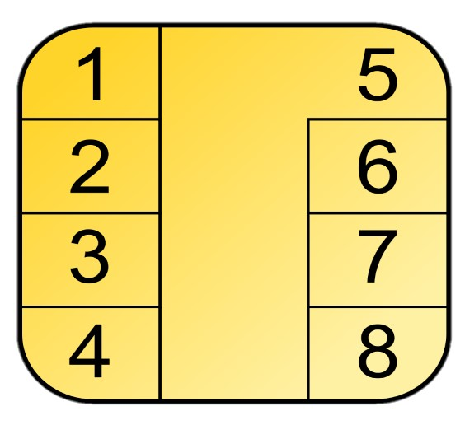
Contact cards (ISO 7816-2)
Vcc
Clock
Reset
5. Ground
6. Vpp
7. I/O
4 & 8 RFU (Reserved for Future Use)
Vcc originally 5 V, now also 3V or 1.8V
  Vpp, higher voltage for writing to EEPROM, no longer used as it introduces security weakness
Clock originally 3.57 MHz or 4.92MHz
I/O speeds in order of > 100 Kbit/s
  C4 & C8 can be used for USB2.0 up to 12 Mbit/s
C6 can be used for Single Wire Protocol (SWP) to connect SIM card to the phone’s NFC antenna

Slide 4
Smart card terminals
Master-Slave communication:
terminal (aka CAD, card acceptance device) is master
smartcard is slave
Hence: terminal takes the initiative,
smartcard cannot initiate actions
For SIM cards a polling mechanism was used to overcome this limitation: the handset would regularly poll the SIM card to ask if it wants to do something

Slide 5
The Terminal Problem!
No I/O between user and card
no display
no keyboard
Why is this a problem?
Some experimental cards with displays, keyboards, or fingerprint readers.

Slide 6
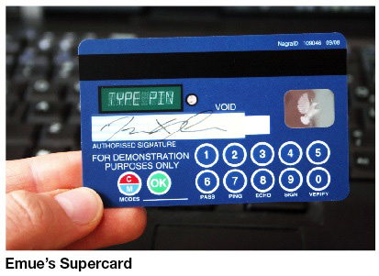
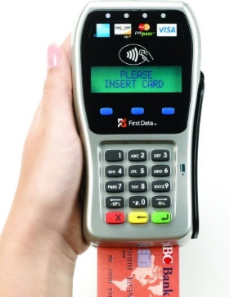
Trusted I/O to the card holder
I/O via devices such as means these have to trusted

Slide 7
Card Activation (ISO 7816-3)
terminal activates card
  earth; voltage; clock; reset
card responds with ATR (Answer To Reset)
  max 33 bytes, usually a lot less (for speed)
  must be sent between 400 & 40,000 clock cycles
    obligatory info about the protocol used
      T=0 byte-oriented
      T=1 block-oriented
    supported baud rate for I/O
    usually some manufacturer info
      id of OS and version no. of ROM mask
    obligatory last byte XOR checksum

Slide 8
APDU communication (ISO 7816-4)
All subsequent communication via APDUs
Application Protocol Data Units
which are just sequences of bytes in particular format
Terminal sends command APDU
Card replies with response APDU
etc, etc ....

Slide 9
Command APDU
CLA class byte
INS instruction byte
P1,P2 parameters
Lc length of data block
Data Lc bytes of data
Le length of expected response
CLA | INS | P1 | P2 | Lc | ...Data .... | Le
obligatory
optional

Slide 10
Response APDU
Data : Le bytes of data (optional)
SW1, SW2 : status word (obligatory)
Data ... | SW1 | SW2

Slide 11
APDU coding conventions
Conventions for CLA, INS etc. are given in ISO 7816-4
Conventions for status word SW1 SW2
  normal processing 61xx, 9000
  warning processing 62xx, 63xx
  execution error 64xx, 65xx
  coding error 67xx, 6Fxx

Slide 12
ISO 7816 standard commands
ISO 7816 also standardises some functionality & associated commands, for
  a file system
  PIN codes
  (building blocks for) authentication protocols
  You do not have to stick to using & implementing these commands, but they may provide inspiration.
  The aim was to standardise the more basic smartcards, where applications are realised by configuring some standard functionality rather than ‘real’ programming.
Other standards for more specific functionality:
  EMV for banking cards
  GSM 11.11 and its superset EN 726-3 for SIM cards
  United Nations ICAO specs for e-passport

Slide 13
PIN verification command in ISO7816
VERIFY command for PIN code verification
    aka CHV = Card Holder Verification = PIN
  ISO 7816-4 defines that Instruction (INS) byte for VERIFY is 20, and class (CLA) byte is 00

Slide 14
Example Authentication Protocols
ISO7816 defines some standard instructions for authentication using challenge-response
For authentication of card
  INTERNAL AUTHENTICATE
    arguments: random, algorithm , key no
    card returns: enc(key,random)
For authentication of terminal
  GET CHALLENGE
    card returns random number
  EXTERNAL AUTHENTICATE
    arguments: enc(key, random), algorithm, key no

Slide 15
Example Authentication Protocols
For mutual authentication
GET CHIP NUMBER
  card returns chip number
GET CHALLENGE
  card returns smart card random, s_rnd
MUTUAL AUTHENTICATE
  arguments: key, terminal random, s_rnd, chip number, algorithm,
  card returns: enc(key, terminal random || s_rnd)

Slide 16
Future
ISO7816 protocol stems from 1980s and it shows!
Slow speed & small size of APDUs can be a bottleneck
Faster communication speeds wanted?
  eg. USB 2.0
More modern protocols wanted?
  There has been an experimental JavaCard 3.0 version that had http(s) support

