Slide 1
Security Protocol Project
Generic Feedback
Cristian Daniele & Erik Poll
Digital Security
Radboud University Nijmegen

Slide 2
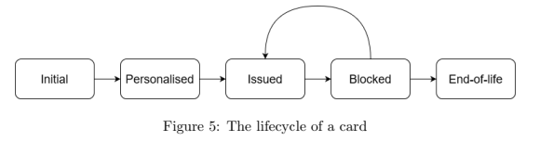
Lifecycle changes
Lifecycle changes can happen by
an explicit action,
  eg. setting some boolean field to false or a byte field to ISSUED
something that happens implicitly,
  eg. a certificate expiring
Mention any actions to change the lifecycle as explicit steps in your protocols
If some lifecycle state (eg. end-of-life) or transition (e.g. unblocking) is not mentioned in any protocol, that is suspicious

Slide 3
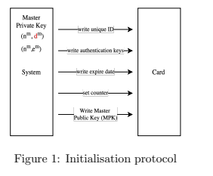
Explicit lifecycle state transitions
Eg. in
good to add explicit state change
state := ISSUED

Slide 4
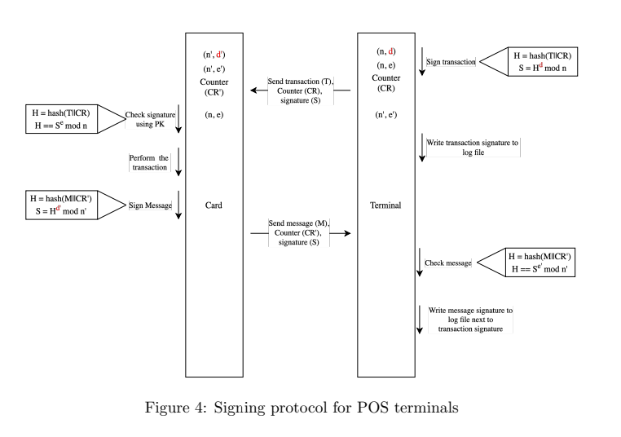
Good to also make other actions explicit
balance =
balance – T
POS displays “paid”

Slide 5
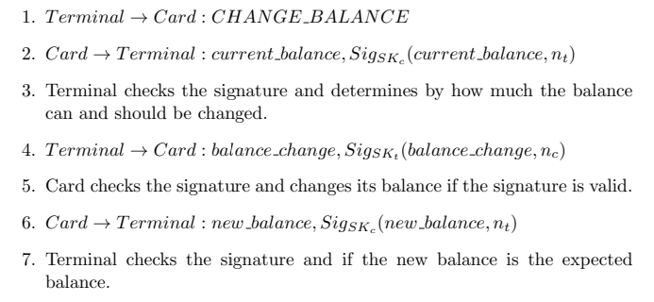
Spot the security flaw
Message 4 includes a nonce n_{c} exchanged in mutual authentication phase.
This ensures ‘freshness’ of the message / ties it to the current session.
But.... it can be replayed within the same session!
Solutions?
Card could set a Boolean flag and refuse a second CHANGE_BALANCE OPERATION or
Card could change (e.g. increment) the value of n_{c}
Good to include such actions as explicit steps

Slide 6
Spot the potential security flaw with step 6
A MitM attacker could replay message 2 as message 6.
  Including more information in the signature to distinguish message 2 and 6 would prevent this. Ideally, all signed messages have unambiguous meanings and can never be reused in the wrong place.
Also, what happens if we do a card tear before step 6?
  Card tears messing with things are unavoidable,
  but check their security impact!

Slide 7
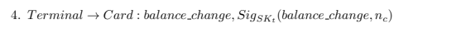
Generic improvement: sign everything
Instead of just signing
balance_change, n_{c}
the protocol becomes more robust if we include signature over
BALANCE_CHANGE, current_balance, n_{c}
where BALANCE_CHANGE is some constant byte for this specific message/operation

Slide 8


WHAT vs HOW
Clearly separate
the security requirement (WHAT)
the way in which that requirement is ensures (HOW)
If you don’t, it is easy for two to get mixed and for design decisions to become implicit.
  Eg why not use a counter instead of random number?
  Or maybe the terminal sends more data, including a nonce, that is signed (rather than encrypted)?

Slide 9
Use case: lost or stolen cards
What happens if cards get stolen or lost?
Reporting a card as stolen or lost would be a separate use case
Decision not to have procedure for this deserves to be explicitly stated & motivated.

Slide 10
Blocking cards
‘Blocking a card’ can be an overloaded term, as it may mean
blocking a card itself
  e.g. setting a EEPROM state flag on the card to BLOCKED
blocking a card in the back-end
e.g. setting some flag in the back-end database
You may have either or both forms of blocking.

Slide 11
Spotting protocol flaws
Authentication MUST use some form of challenge-response
  Just exchanging & certificates is not enough!
  The challenge has to be a nonce, which can be a random number OR a counter
Double-check that message that triggers the actual transaction cannot be replayed within a transaction
Beware of unauthenticated responses eg a card or terminal saying OK

Slide 12
Spotting protocol flaws/improvements
If you have a session key, it is dangerous to let only one party decide the session key
  Better - or necessary – to let both parties contribute randomness
MACing or signing data with long-term (private) key provides a stronger guarantee than MACing with a session key
If you use encryption in your protocol, double-check if there is a corresponding security requirement about confidentiality
  Unless it is encryption of a nonce for authentication, of course

Slide 13
Certificates
A certificate is not a just a signed public key,
it is a signed blob of information that includes a public key
A typical certificate will be
(id || PubKey_{id} || expiry-date || type-info || ...)
signed by a public master key
Or, more formally,
Cert_{id} = Signed_{PubKeyM}(id || PbK_{id} || expiry-date || ...)
where
Signed_{PK} (m) = m || Enc_{PK}(hash(m))

Slide 14
Potential improvement?
Presumably expiry is the same as endoflife
Is there a way to distinguish the certificate of a smartcard and the certificate of terminal?
Could an attacker steal a certificate and private key from a terminal and use that info make a fake card, or vice versa?
You could use different ranges of IDs for cards & terminals, but clearer to include an explicit byte field in the certificate to indicate a type

Slide 15
IDs
If a card (or terminal) has its own keypair, then you can use public keys to identify that card.
But it is much cleaner to give cards and terminals unique identifier cid and tid as well as own keypairs
  You might want to have customer-id’s and card-id’s

Slide 16
Defense in Depth
What if...? one of your security assumptions is broken
Would you be able to detect it if
a malicious insider issues loads of cards?
a malicious POS operator gives away free points or redeems non-existent points?
a malicious shop owner claims too much money, eg by duplicating transactions?
a card is cloned?
key material from a terminal leaks?
a terminal is hacked to compromise its behaviour?
...
Logging & procedures to inspect logs can help

Slide 17
Stylistic advice

Slide 18
Avoid duplication
Duplication is bad in code, but also in text,
so avoid it in your report
  when describing protocols, giving definitions, discussing attacker models, listing security requirements, ...
It is better to have fewer SRs than many SRs
  so avoid duplicating or overlapping security requirements

Slide 19
Notation
Be aware of the difference between
  constants, e.g. BLOCKED , OK OR, CHANGE_BALANCE
  program variables, e.g. state
  meta-variables for values used in protocols
    e.g. amount , card_id , terminal_id , or PIN_guess
  Different fonts & capitalisation can help to distinguish them
Be aware of different meanings of = which include
  mathematical definitions
    EncSign _{K1,K2} (m) =_{def} Enc_{K1}(m) || Enc_{K2}(hash(m))
  assignments in code
  state := PERSONALISED

Slide 20
Notation
Introduce convenient mathematical functions & notation
Eg
    m = Encrypt_{K} (amount || card_id || nonce )
    (amount, cid, time) = Decrypt_{K} (payload)
    m₂ = DecryptAndCheckSignature_{K1,K2} (m₁) ; abort if signature incorrect
Numbering steps in protocols can be useful
  also when you start coding

