Slide 1
Type safety of Simply Typed Lambda Calculus
Maud van de Lockant
Susan Withaar

Slide 2
Table of contents
Introduction type safety
Type safety theorem
Logical relations for type safety
Proof in two steps
Semantic well-typedness

Slide 3
Definition simple typed lambda environment

Slide 4
Type safety
“well-typed programs do not go wrong.” -Robin Milner
“well-typed programs do not get stuck.”

Slide 5
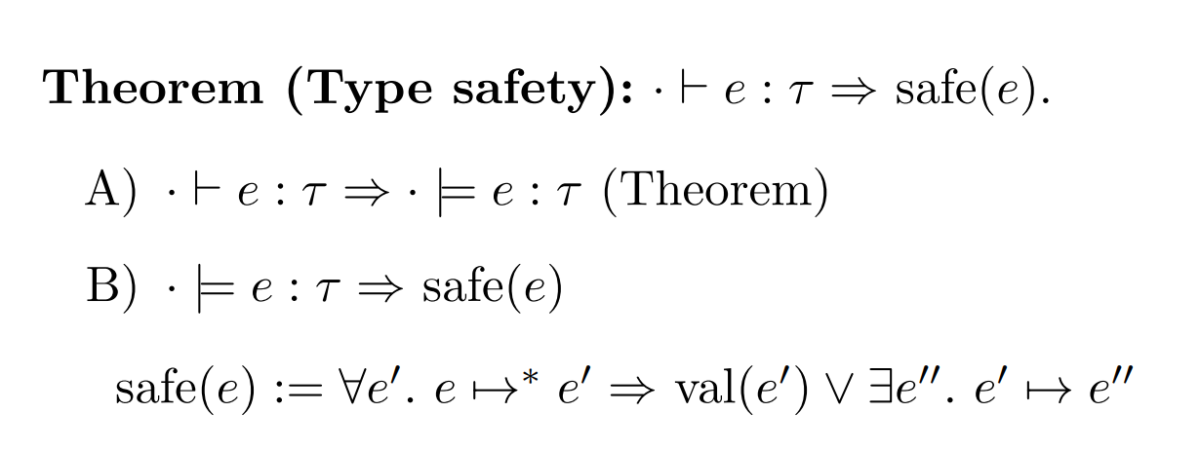
Type safety theorem

Slide 6
Logical relations for type safety

Slide 7
Semantic well-typedness

Slide 8
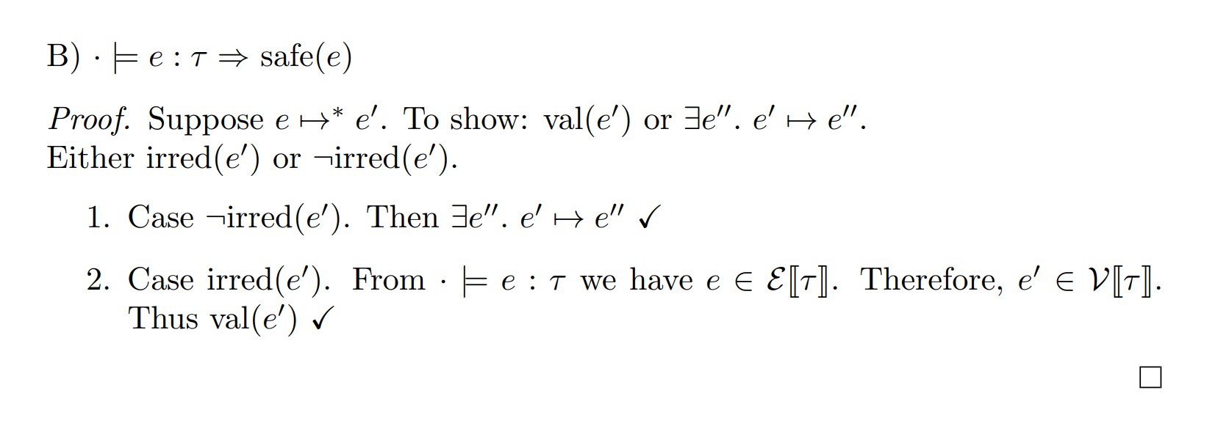
Proof of part B

Slide 9
Fundamental Property/Basic Lemma Theorem (A)

Slide 10
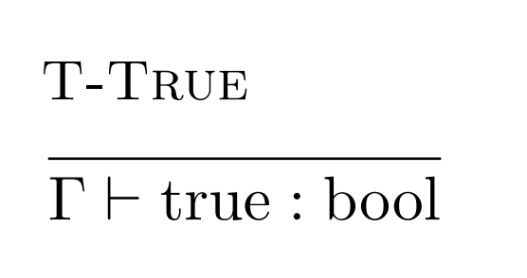
Fundamental Property/Basic Lemma Theorem (A)

Slide 11
Fundamental Property/Basic Lemma Theorem (A)

Slide 12
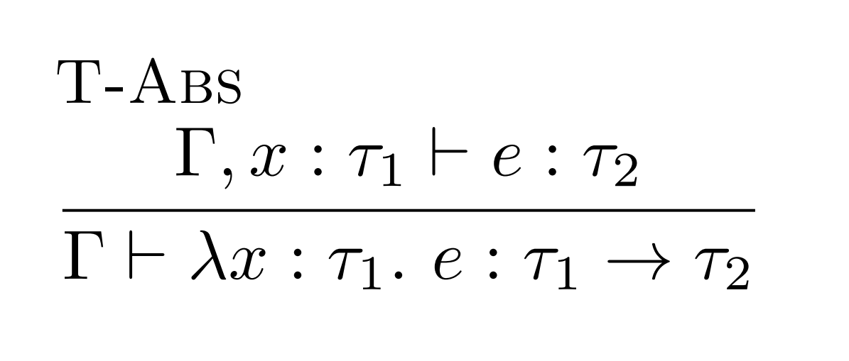
Fundamental Property/Basic Lemma Theorem (A)

Slide 13
Fundamental Property/Basic Lemma Theorem (A)

