Slide 1
Software Security
Secure input handling
Erik Poll
Digital Security
Radboud University Nijmegen

Slide 2

_{Input} problems, which involve _{parsing}
Most security problems are input problems, where input is passed around to trigger bugs or features
This always involves parsing of some format/language
e.g. TCP/IP packets, PDF, Word, JPEG, SQL, path/file names, URLs, ...
input

Slide 3
Secure input handling
Last week: preventing input problems with
Validation
Sanitisation (aka encoding)
Canonicalisation
This week: more ‘structural/foundational’ solutions to rule out
Tackling buggy parsing with LangSec
How (not) to tackle unintended parsing - ie injection flaws
  Input vs output sanitisation
  Taint Tracking
  Safe builders
    Case study: XSS

Slide 4
How encoding can complicate matters
Chrome used to crash on the URL http://%%30%30
  %30 is the URL-encoding of the character 0
  So %%30%30 is the URL-encoding of %00
  %00 is the URL-encoding of null character
  So %%30%30 is a double-encoded null character
  Cause of the crash: some code/API deep inside Chrome performs a second URL-decoding (as well-intended ‘service’ to its client code?) and then other code crashes on the resulting null character.
How could this bug have been detected or prevented?
Having encoded data around makes validation harder! Double encoding is a common way to get past validation checks.
  Note that encoding is the opposite of canonicalisation: it introduces different representations of the same data.
Problem: keeping track of which data is encoded / may be decoded can be tricky in larger programs.

Slide 5
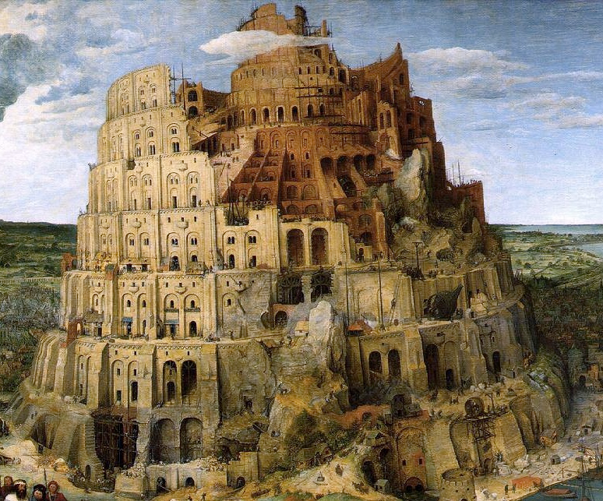
I. Tackling buggy parsing
- using the LangSec approach

Slide 6
Buggy parsing
Here by buggy parsing we mean
insecure parsing
  Eg. buffer overflow in Office, PDF viewer, network stack, graphics library, ..
incorrect parsing resulting in parser differentials, i.e. two libraries parsing the same URL in different ways

Slide 7
Can we use input validation?
Suppose we have a buggy PDF viewer with memory corruption that allows RCE.
  Can we use input validation as protection?
Yes & no:
  we could validate a PDF file before feeding it to our PDF viewer,
  but... for that we need a correct & secure PDF parser, so we are back to the original problem
  Still, for legacy applications it may be an improvement

Slide 8
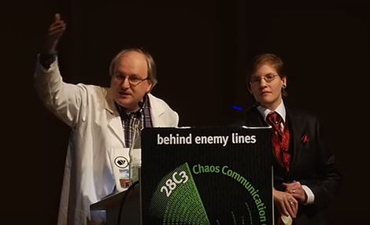
LangSec (Language-Theoretic Security)
Interesting look at root causes of large class of input handling bugs, namely buggy parsing
Useful suggestions for dos and don’ts
The ‘Lang’ in ‘LangSec’ refers to input languages, . not programming languages.
Sergey Bratus &
Meredith Patterson
presenting LangSec at CCC 2012
‘The science of insecurity’

Slide 9
Root causes / anti-patterns
Complex input language or format
Sloppy definitions of this input language or format
Hand-written parser code
Mixing input recognition & processing in shotgun parser

Slide 10
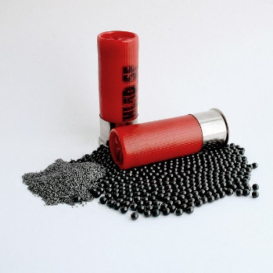
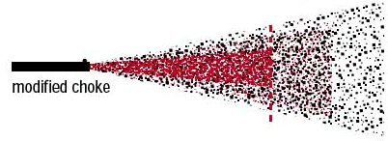
Anti-pattern: shotgun parser
input
parser
Fragments of input penetrate deeply, and any code that touches these fragments may contain exploitable input bugs.
Code incrementally parses & interprets input, in a piecemeal fashion, chopping it up for further parsing elsewhere
Fragments passed around as unparsed byte arrays or strings
Notes:
restrict the language, enforce this in the front-end? validate/sanatise inputs? or outputs?

Slide 11
LangSec concepts
Shotgun parser: shattershot approach to parsing data in bits and pieces, mixing recognition (i.e. the actual parsing) & processing
Weird machine: a buggy parser provides a strange execution platform that can be ‘programmed’ with malformed input
  This weird machine may even be Turing-complete (recall ROP programming with gadgets)
  Cool example: executing code on a x86 processor just using page faults, without ever executing CPU instructions
    [Bangert, Bratus, Shapiro, and Smith, The Page-Fault Weird Machine: Lessons in Instruction-less Computation, USENIX WOOT 2014]

Slide 12
LangSec principles to prevent buggy parsing
No more hand-coded shotgun parsers, but
precisely defined input languages
  ideally with regular expression or context-free grammar (eg EBNF)
generated parser code
complete parsing before processing
keep the input language simple & clear
  So that bugs are less likely
  So that you give minimal processing power to attackers

Slide 13
Preventing buggy parsing - the LangSec way
application
input
parser
Some C struct,
Java/C++ object,
or error
LangSec approach:
Clear & ideally formally defined input specification
Generated parser code
Complete parsing before processing
  rest of the program only handles well-formed data structures produced by parser
Notes:
restrict the language, enforce this in the front-end? validate/sanatise inputs? or outputs?

Slide 14
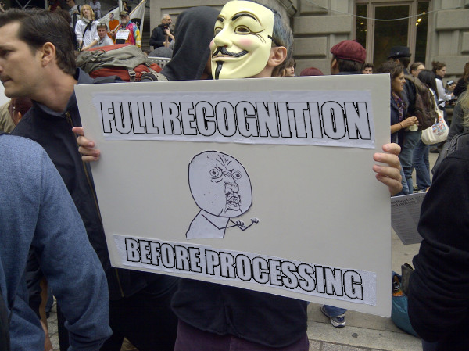
LangSec in slogans

Slide 15
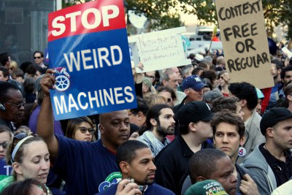

Slide 16
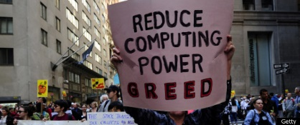
Minimise the resources & computing power that input handling gives to attackers

Slide 17
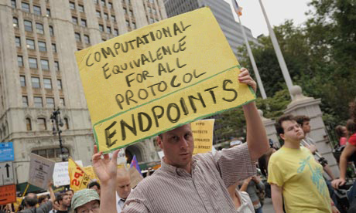
All parsers should be equivalent.
And parsers should be the exact inverse of the pretty printers aka unparsers

Slide 18
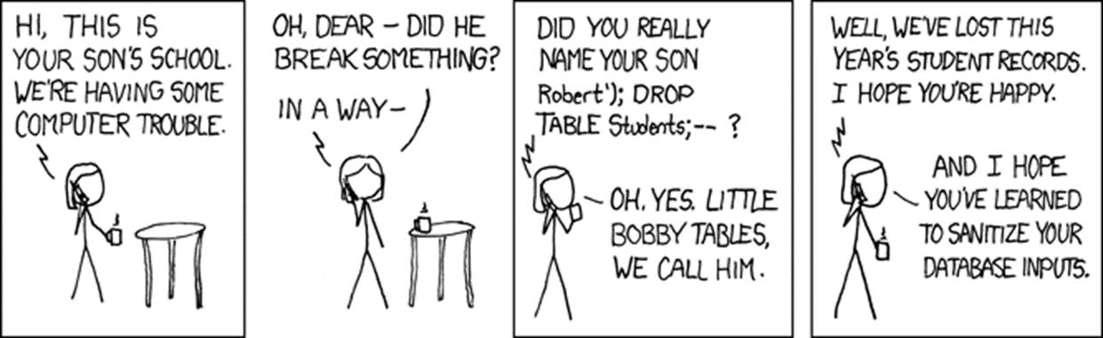
II. How (not) to prevent injection attacks

Slide 19
How & where to prevent injection attacks?
- name
- address
Suppose we are worried about SQL injection via a website
Should we validate, sanitise, or both to prevent SLQi?
if so, where? At point A or B?
We assume we know a perfect allow-list or deny-list of dangerous characters for SQL injection.
We ignore canonicalisation of name & address.
We ignore validation to make sure that eg. the address exists.
OnlineShop.nl
customer database
A
B
C
Notes:
restrict the language, enforce this in the front-end? validate/sanatise inputs? or outputs?

Slide 20
Input validation ?
Input validation, i.e. rejecting weird characters at point A
Pros?
Eliminates problem at the source root, so application only has to deal with ‘clean’ data
Cons?
We may reject legitimate inputs, eg ’s-Hertogenbosch
OnlineShop.nl
customer database
A
B
Notes:
restrict the language, enforce this in the front-end? validate/sanatise inputs? or outputs?

Slide 21
Input sanitisation?
Input sanitisation, e.g. escaping weird characters at point A
Eg replacing ’ with \’
Pros?
Eliminates problem at the source root, so application only has to deal with ‘harmless’ data
We no longer reject legitimate input
Cons?
We have some data in escaped form, \’s-Hertogenbosch and may need to un-escape it later
Also, what if there are more back-end than just SQL dataset?
OnlineShop.nl
customer database
A
B
Notes:
restrict the language, enforce this in the front-end? validate/sanatise inputs? or outputs?

Slide 22
Multiple backends/APIs introduce multiple contexts
Different escaping needed to prevent SQLi, XSS, path traversal, OS command injection, …
  Eg SQL database may be attacked with username Bobby; DROP TABLE but file system with username ../../etc/passwd and email program with username john@ru.nl; & rm –fr /
For most systems, it’s a fallacy to think that one input sanitisation routine can solve all injection problems
customer database
OnlineShop.nl
A
B
HTML renderer
email program
file system
Notes:
restrict the language, enforce this in the front-end? validate/sanatise inputs? or outputs?

Slide 23
Output sanitisation! aka output encoding
customer database
If we sanitise outputs instead of inputs then sanitisation can be tailored to the context:
  for SQL database ; ’ ” DROP TABLE
  for HTML renderer < > & script
  for file system . .. / \ ~
  for OS command & | || < >
OnlineShop.nl
B1
A
B2
HTML renderer
B3
file system
B4
email program
Notes:
restrict the language, enforce this in the front-end? validate/sanatise inputs? or outputs?

Slide 24
Output encoding to prevent injection attacks
We can prevent injection attacks by careful output encoding - in the right place, using the right encoding function.
However, this is easy to get wrong...
More structural approaches to prevent or spot mistakes:
Prepared statements aka Parameterised queries
  Easy to get right – as it gets rid of the problem.
  But... only works in simple settings
Tainting
  Using DAST or SAST tool to spot or add missing encodings
Safe Builders
  Using type system to prevent missing or wrong encodings

Slide 25
a) Prepared Statements

Slide 26
Dynamic SQL vs Prepared statements
Interface with SQL database can use
Dynamic SQL:
one string, which includes user input, is provided as SQL query
  "SELECT * FROM Account WHERE Username = " + $username
  + "AND Password = " + $password
Prepared statements aka parameterised queries:
a string with placeholders is provided as query, and user inputs are provide as separate parameters
  "SELECT * FROM Account WHERE Username = ? AND Password = ?“ $username $password

Slide 27
Dynamic SQL & prepared statements in Java
Code vulnerable to SQLi using dynamic SQL
  String updateString =
  "SELECT * FROM Account WHERE Username"
  + username + "AND Password =" + password;
  stmt.executeUpdate(updateString);
Code not vulnerable to SQLi using prepared statements
  PreparedStatement login = con.preparedStatement("SELECT * FROM Account
WHERE Username = ? AND Password = ?" );
  login.setString(1, username);
  login.setString(2, password);
  login.executeUpdate();
bind variable

Slide 28
The idea behind prepared statemens
(aka parameterised queries)
SELECT ... FROM ... WHERE ...
*
Accounts
AND
=
=
Username
$1
Passwd
$2
Prepared Statements: the query is parsed first and then parameters are substituted later
Dynamic SQL: parameters are substituted first and then the result is parsed & processed
Key insight: we do not parse the parameters as SQL, so the substitution becomes less dangerous

Slide 29
Prepared Statements as solution to SQLi
Problem: user inputs s_{i} are substituted in a command c, which is then parsed & executed by some API, ie.
unsafeAPImethod (c[x₁:=s₁]...[x_{n}:=s_{n}])
Solution: provide command and user inputs as separate arguments, so API methods know which bits to parse & execut,e and which not, ie.
safeAPImethod (c, s₁, .., s_{n})
Under the hood, the API could simply apply the right encoding operation to the parameters s_{i}
Here c[x:=s] means c with all occurrences of x replaced by c

Slide 30
Limitation of this approach, more generally
as general technique to prevent injection attacks
Requires custom solution for each injection-prone API method
  Eg for safe LDAP queries, safe XPath queries,....
Only works for simple situations that
  involve just one encoding function
  involve only simple substitution patterns
  This means we cannot use it to combat XSS (more on that later)
  Also, it may not be able to express some highly configurable fancy SQL queries

Slide 31
Prepared Statements not quite fool-proof
Prepared statements are easy to use, but not quite fool-proof
  PreparedStatement login = con.preparedStatement
  ("SELECT * FROM Account WHERE Username"
  + username + "AND Password =" + password);
  login.executeUpdate();

Slide 32
b) Tainting

Slide 33
Tainting aka Taint analysis
Core idea is to use data flow analysis:
we track & trace user inputs – aka tainted data
If tainted data ends up in a dangerous API, we give a warning
Like SAL annotations SA_Pre[Tainted=True] in PREfast, but inferred automatically
Such an analysis needs to know
all sources & sinks
all operations that combine data and propagate taint
  eg concatenation of two strings is tainted if one of them is
all operations that sanitise data and remove taint
  eg SQLencoding removes taint (as far as SQLi is concerned)
Taint analysis can be done dynamically (DAST) or statically (SAST)

Slide 34
Dynamic & static taint analysis
Perl scripting language first introduced a taint mode in 1989
  external input are marked & tracked
  perl execution engine aborts when tainted data is fed to dangerous functions
  It looks like Perl 6 will remove taint mode
Windows/Microsoft Office does taint tracking of documents using the Mark of the Web to then block / warn users about macros in tainted document
  Rules have been tightened in March 2022; maybe macros attacks will become a thing of the past?
Most SAST tools (incl. Fortify, discussed in SIO lecture) use static taint analysis to provide warnings about inputs reaching dangerous sinks (without being validated/encoded).

Slide 35
Tainting limitations?
Multiple sanitisation operations, for different types of data/different sinks (eg SQL vs HTML), complicate matters
  Accurate analysis requires different kinds of taint
There may be many sources, many sinks and many operations that remove or propagate taint, or possibly propagate taint
  Missing one is easy, resulting in false negatives or positives.
  Too much data may get tainted, resulting in unworkable number of false positives.
Static taint analysis of large programs becomes complex.
  False positives or false negatives may be unavoidable.
  Doing intra-procedural analysis (i.e. per method/function) instead of inter-procedural analysis (i.e. whole program) may keep things feasible, typically at the expense of precision

Slide 36
c) Safe builders

Slide 37
Safe Builder approach
Effectively the opposite approach to tainting:
    instead of tracking tainted / dangerous data, we track untainted / safe data.
Key idea: we use type system of the programming language to distinguish
  ‘trusted’ data that does not to be encoded
  ‘untrusted’ data that needs to be encoded
  data encoded for a specific context with a different type for each context
  One special addition to conventional type systems: distinguishing compile-time constants (esp. string literals)
Used by Google’s Trusted Types in Chrome to combat DOM-based XSS.

Slide 38
Safe builder for SQL injection
Suppose we have an unsafe API method
void executeDynamicSQLQuery (String s)
We define a new ‘wrapper’ String type SQLquery and a function that executes such a wrapped string
  void safeExecuteSQLQuery (SafeSQLquery s){
  executeDynamicSQLCommand(the string in s );
  }
We now define functions to create SafeSQLquery
  any compiled-time constant can be turned into a SQLquery
    SafeSQLquery create (@CompiletimeConstant String s)
  we can append a string to an SafeSQLquery using a function
  SafeSQLquery appendSQL (SafeSQLquery q, String s)
  which will apply the right encoding to s
Type system guarantees that user inputs in queries are properly escaped.
We disallow use of the old unsafe executeDynamicSQLQuery .

Slide 39
Safe builders for several contexts
If we use string-like data in several contexts, each with their own encoding, we can introduce a different String-like typesa for each, e.g.
SafeSQLquery, SafeHTML, SafeOSCommand, SafeFilename
with association constructors or factory methods for each, e.g.
SafeHTML create (@CompiletimeConstant String s)
SafeHTML concatHTML (SafeHTML h1, SafeHTML h2)
SafeHTML appendHTML (SafeHTML h, String s)
appendHTML(h,s) and appendSQL(h,s) would use different encodings for the parameter s
We could introduce unsafe loopholes that we evaluate by hand
SafeHTML unsafeCreate (String s)

Slide 40
Positive vs negative security models
The choice between positive vs negative security models comes back in several places
Tainting = data is 'safe' unless tainted,
Safe builders = data is 'unsafe' unless type says otherwise
allow lists vs deny lists
security requirements vs attack scenario/threat

Slide 41
The messy business of preventing XSS

Slide 42

Reflected XSS attack
Attacker crafts malicious URL containing JavaScript
https://google.com/search?q=<script>...</script>
and tempts victim to click on this link
Could careful web server prevent this?
Yes, by validating & rejecting and/or encoding content in query!
1.malicious
URL
server
2. HTTP request with
malicious link
victim’s
browser
3. HTML response containing <script> ... </script>

Slide 43

Stored XSS attack
Attacker injects HTML into a web site, eg forum posting in Brightspace, which is stored and echoed back later when victim visit the same site
Could careful web server prevent this?
Yes, by rejecting and/or encoding content when it is stored or retrieved
1. malicious input
2. malicious input stored
server
data
base
3. HTTP request
4. malicious content retrieved
victim’s
browser
5. response with malicious HTML content

Slide 44
Encoding HTML content - server-side
Many sites use web templating framework to generate web pages.
Below a web template for a web page with parameters written as ${...}
1 '<html>
2 <body>
3 <h1> ${name}&apos;s Blog! </h1>
4 ${description}
5 <a href="https://ourdomain.nl/contact?user=${username}&lang=${lang}">User info for ${name} </a>
6 <b onmouseover=alert("Welcome to ${firstname}’s page")>Click here for a pop-up</b>
7 </body>
8 </html>'
Parameters – properly encoded – are filled by web server / templating engine.
How should the parameters be encoded here?

Slide 45
Encoding for the web - server-side
'<html>
<body>
<h1> ${name}&apos;s Blog! </h1>
${description}
<a href="https://ourdomain.nl/contact?user=${username}&lang=${lang}">Contact details for ${name} </a>
<b onmouseover=alert("Welcome to ${firstname}’s page")>Click here for a pop-up</b>
</body>
</html>'
NB all these encodings can be done server-side
Getting this right is tricky!
HTML encoding (eg of < and > )
URL encoding (eg of ?)
JavaString literal encoded (eg of ' and " )

Slide 46
Some of the encodings for the web
HTML encoding
  < > & ” ’ replaced by &gt; lt; &amp; &quot &#39
  Complication: encoding of attribute inside HTML tag may be different
URL encoding aka %-encoding
  / ? = % # replaced by %2F %3F %3D %25 %23
  space replaced by %20 or +
  Try this out with e.g. https://duckduckgo.com/?q=%2F+%3F%3D
  Complication: encoding for query segment different than for initial part, eg for / aka %2F
JavaScript string literal encoding
  ’ replaced by \’
  Eg ’this is a JS string with a \’ in the middle’
  Complication: JavaScript allows both ' and " for strings
CSS encoding
...

Slide 47
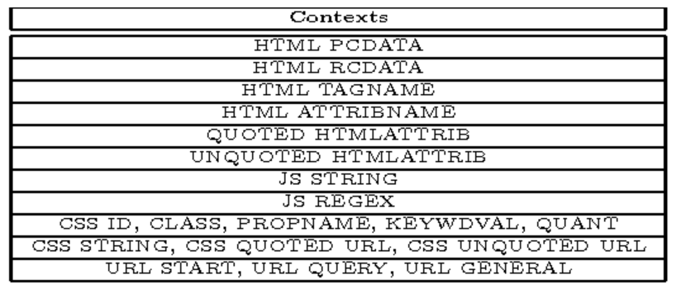
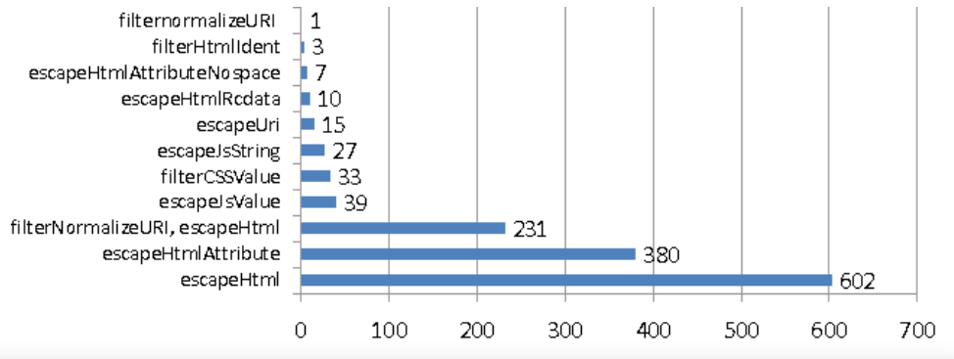
Context-sensitive auto-escaping
Context-sensitive auto-escaping web template engines try to figure out & insert the right encodings.
  E.g. Google Closure Templates, using context & encodings below
Many template engines are not context sensitive, and hence insecure!
encodings inserted
contexts (type qualifiers)
[Samuel, Saxena, and Song, Context-sensitive auto-sanitization in web templating languages using type qualifiers, CCS 2017]

Slide 48
Extra complication: the DOM API
JavaScript inside a web page can dynamically alter that web page using the DOM API (or do other interactions with other Web APIs)
<html> <body>
<h1 id=title> ${name}&apos;s Blog </h1>
...
<script> let newName = getSomeData();
document.getElementById("title") .innerHTML = newName + "&apos;s Blog!";
<script>
</body> </html>
Spot the XSS!
A malicious newName could be Eve</h1><script someAttackScript();</script> //
If newName is untrusted user input, it needs to be encoded, by the JS code:
document.getElementById("title").innerHTML = htmlEscape(newName) + "&apos;s Blog!"
DOM API methods & fields
to inspect & alter the web page

Slide 49
DOM-based XSS attacks
JavaScript code in a webpage is fed some malicious input (client-side!) and uses that input to change the webpage (client-side!)
Input can come 1) via local user input, 2) as parameters in the URL, 3) from the server (as in stored XSS), 4) from another web server,...
Server cannot validate or encode such inputs! (Except in case 3?) It has to be done by JS code inside the web page.
web
server
bad
page.html
page.html
f(bad)
f(bad)
f.js
JS engine
bad.html
HTML renderer

Slide 50
tot hier

Slide 51
Escaping inside JavaScript
Suppose we want JS code to create/change an HTML element elem into a link, labelled with a user-supplied name, that executes JS code createAlbum('name') when clicked, i.e. <a onclick="createAlbum('name')">name</a>
Insecure JS code to do this
elem.innerHTML = '<a onclick="createAlbum(\'' + name + '\')">' + name + '</a>';
Spot the XSS bug!
As malicious name insert ' '; someAttackScript(); //
How to escape name for the two different contexts here?
var escapedName = goog.string.htmlEscape(name); // HTML-encoding
var jsEscapedName = goog.string.escapeString(escapedName); // JS string literal encoding
elem.innerHTML = '<a onclick="createAlbum(\'' + jsEscapedName + '\')">' + escapedName + '</a>';
Spot the XSS bug!

Slide 52
Spot the XSS bug!
var escapedName = goog.string.htmlEscape(name); // HTML-encoding
var jsEscapedName = goog.string.escapeString(escapedName); // JS string literal encoding
elem.innerHTML = '<a onclick="createAlbum(\' ' + jsEscapedName + '\')">' + escapedName + '</a>';
Attack: enter malicious name ');attackScript();//
HTML-escaped this becomes &#39;);attackScript();//
JS-escaped this remains &#39;);attackScript();//
So innerHTML becomes
<a onclick= "createAlbum(' &#39;);attackScript();// ')">&#39;);attackScript();//</a>
The browser HTML-unescapes value of onclick attribute before evaluation as JS
createAlbum(' ');attackScript();//')
so attackScript(); will be executed
[Example from Christoph Kern, Securing the Tangled Web, CACM 2014]

Slide 53
Preventing DOM-based XSS
Writing JavaScript code that properly validates and encodes user input is hard!
  Modern web pages use a LOT of client side JS code, using large libraries, to provide fancy webpages
The DOM API methods take strings as arguments, but for these strings it is hard to trace
where they come from? (are they user input?)
have they been validated? if so, how exactly?
have been encoded? and if so, how exactly?
Here we can use the safe builder approach!

Slide 54
API hardening for the DOM API (aka Trusted Types)
Safe builder approach for JavaScript & DOM API
use TypeScript rather than JavaScript
use different types instead of just String, e.g. TrustedHtml, TrustedJavaScript, TrustedUrl, TrustedScriptUrl …
replace string-based DOM API with new typed API where operations take the right 'safe' type as parameter
  eg innerHTML takes TrustedHtml instead of a String
Typing guarantees proper escaping & validation ☺
  This is checked statically
DOM API must be replaced & all JS code needs to be rewritten ☹
but ... this can be done incrementally, using old & new APIs side by side
[https://github.com/WICG/trusted-types]
[Released as a Chrome browser feature in 2019
  https://developers.google.com/web/updates/2019/02/trusted-types]

Slide 55
Custom tweaks
The Trusted Types / API hardening approach can be customised/extended to specific application:
  For example, Brightspace allows a restricted set of HTML tags in forum postings.
  To do this we would introduce
  introduce a custom type, SafeForumPosting
  specify which functions require input of this type
  define custom operations to generate data of this type, with built-in validation and/or encoding.
  This code should be rigorously reviewed to make sure it is bullet-proof!

Slide 56
Yet another complication: different kind of URLs
Suppose we let users add a link to jump to their homepage on another website
<html> <body>
<h1> ${name} &apos;s Blog! </h1>
${description}
...
<script> function goHome() { window.location.href = ${homeUrl} ;} </script>
<button type="button" onclick="goHome()">Click here to go to ${name} 's home page!</button>
...
Spot the XSS, if we allow users to specify any ${homeUrl}
Browsers support pseudo URLs starting with javascript:, e.g. javascript:alert('Hi!').
Assigning such a URL to location.href will execute the script!
User-supplied URLs have to be validated to check for javascript: URLs:
server-side, of if its passed around in JS, client-side in JS code
The Trusted Types API uses special type TrustedResourceUrl for sinks, such as location.href, where (pseudo) URLs can trigger execution of scripts

Slide 57
Recap: Why XSS is so tricky to prevent
Many sources & sinks, with complex data flows between them
Many different types of data
    URLs, URL parameters, javascript: pseudo URLs, (snippets of) HTML and JavaScript, JavaScript strings, CSS, …
  with different trust levels, eg
  HTML with scripts that we trust,
  unsafe HTML possibly with scripts,
  safe HTML without scripts, links that we trust even in places where they might trigger scripts, links that we trust except in places where they might trigger scripts,
  ...
  and different association forms of encoding and validation, eg
  HTML-encoding, JavaString-literal encoding, URLs validated not to start with javascript:, ...
  that can be done server-side or client-side

Slide 58
Conclusions

Slide 59
Languages & Parsing
Parsing of many languages (formats, representations, ...) is where input problems happen, due to
  insecure parsing
  incorrect parsing, i.e. parsing differentials
  unintended parsing, i.e. injection attacks
  especially if languages are complex, poorly defined, and very expressive
LangSec approach can prevent buggy parsing which can be insecure parsing or incorrect parsing
Safe builder approach, which generalises parameterised queries, can prevent injection attacks

Slide 60
Validation vs Sanitisation/Encoding/Escaping
Validation and sanitisation/encoding/escaping are two very different operations
Output encoding makes more sense than input sanitisation, because encoding/sanitisation depends on context
Ideally, don't validate but parse
Ideally, use ‘safe’ APIs that are immune to injection using types to enforce proper sanitisation & validation

Slide 61

Anti-pattern: string concatenation
Standard recipe for security disaster:
concatenate several pieces of data, some user input,
pass the result to some API
Note: string concatenation is inverse of parsing

Slide 62
Anti-pattern: strings
The use of strings in a warning sign
  not just String but also char*, char[], StringBuilder, ...
Strings are useful, because you use them to represent many things:
eg. username, file name, email address, URL, HTML, …
This also make strings dangerous:
Strings are unstructured data that still needs to be parsed
The same string may be handled & interpreted in many – possibly unexpected – ways
Strings may or may not be validated or encoded, ...
A single string parameter in an API call often hides an expressive & powerful language

Slide 63

Pattern: Use Types
Types can record & ensure various aspects of data
origin of data, and hence the trust we have in it
  special mention: compile-time constants
language/format it is intended for
validated or not, and how exactly?
encoded or not, and how exactly?
preventing ambiguity & confusion

Slide 64

To read
Wang et al., If It's Not Secure, It Should Not Compile: Preventing DOM-Based XSS in Large-Scale Web Development with API Hardening, ICSE'21, ACM/IEEE, 2021
Lectures notes on Secure Input Handling

