Slide 1
Software Security (All?) other kinds of problems
Erik Poll
Digital Security
Radboud University Nijmegen

Slide 2
abuse of features (eg spam)
supply chain weakness
design flaws
feature interaction
use of broken / misconfigured components
weak / flawed
authentication
broken access
control
flawed program logic
Not to scale!
Very
incomplete!
Vague boundaries,
overlaps &
combinations
phishing vulnerabilities
error handling
no 2FA
CSRF
hardcoded
secrets
leaked
credentials
TOCTOU/
race conditions
integer overflow
injection attacks
memory corruption
SQLi
HTML
injection
buffer overflow
double
free
format string
XSS
dangling
pointer
implementation
flaws
memory leaks

Slide 3
abuse of features (eg spam)
supply chain weakness
design flaws
feature interaction
use of broken / misconfigured components
weak / flawed
authentication
broken access
control
flawed program logic
Not to scale!
Very
incomplete!
Vague boundaries,
overlaps &
combinations
phishing vulnerabilities
error handling
no 2FA
CSRF
hardcoded
secrets
leaked
credentials
TOCTOU/
race conditions
buggy
parsing
unintended
parsing
integer overflow
injection attacks
memory corruption
SQLi
HTML
injection
buffer overflow
double
free
format string
XSS
dangling
pointer
implementation
flaws
memory leaks

Slide 4
Access Control

Slide 5
Access control - basic concepts
Access control consists of two steps
authentication - checking who you are
authorisation - enforcing what you are allowed to do
Often when people say 'access control' they just mean 2.
Access control, more specifically authorisation, is configured by means of a policy
Where can we expect problems?

Slide 6
Problems with access control
Where can we expect problems?
Authentication can be weak or broken
incl. stealing credentials
Authorisation can be misconfigured
esp. if policies are _{complex}
Access control may be missing / circumventable

Slide 7
Insecure Direct Object Reference (IDOR)
Typical scenario
User U requests some resource R (e.g. a file, webpage)
Access control system checks if user is allows to access
If so, user is given a reference to the resource
eg https://brightspace.ru.nl/lms/dropbox/admin/folders_manage.d2l?ou=331358.pdf
What could be a potential access control problem?
Is access control check repeated when the link is used?
What if the user changes the link, to 331359.pdf, 331360.pdf, ...
What if the user passes on this reference to someone else?
Insecure direct object reference: users are provided a direct reference to some object after access control check, but access control check is not repeated when they use that reference.
Note: this looks a lot like path tranversal.

Slide 8
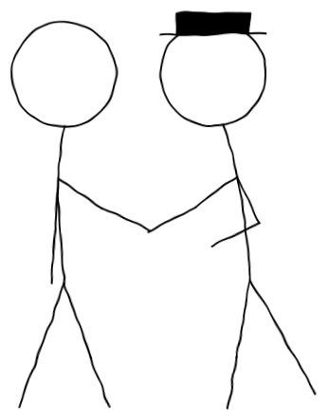
The confused deputy problem
A less privilege user/process A asks a more privileged user/process B to do something
A B
If B does that with its access rights, A can by-pass access control.
This is an input handling problem,
but also an access control or privilege escalation problem
Many input handling & access control problems involve a confused deputy.
Phishing also involves a confused deputy!

Slide 9
CSRF (Cross Site Request Forgery)
Suppose a bank transfer on bank.com is done with a simple click of
<a href=”transferMoney?amount=1000&toAccount=52.12.57.762”>
Then attackers can create malicious links
<a href=”https://bank.com/transferMoney?amount=1000
&toAccount=52.12.57.762”>
and insert such links on mafia.com or in HTML-formatted email.
If browser follow such links, attaching its cookie for bank.com , we have an CSRF attack.
Note: CSRF is an instance of a confused deputy attack.
CSRF is uncommon these days, as most websites use more robust session management solutions than just an authentication cookie.

Slide 10
Authentication solutions
Authentication of humans by computers
passwords, PIN codes, biometrics (fingerprint, face), smartcards & other hardware tokens, MFA, ...
Authentication of computers by computers (or computer applications)
cryptography (symmetric; or asymmetric, maybe using certificates & PKI), Kerberos tickets, SMB pass the hash, API keys, ...
Authentication of computer applications by humans
People often forget about this!
URLs, info provided by browsers, applications, app stores, ...
Phishing attacks this form of (usually weak) authentication
Phishing is a software design flaw !

Slide 11

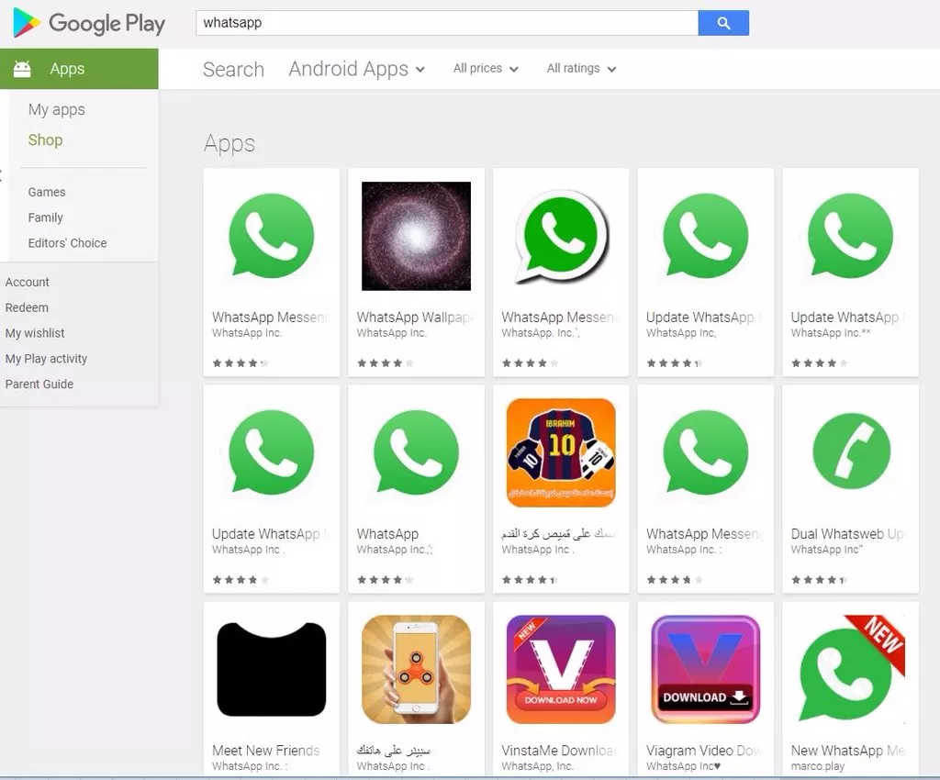
Problems in authenticating apps by humans

Slide 12
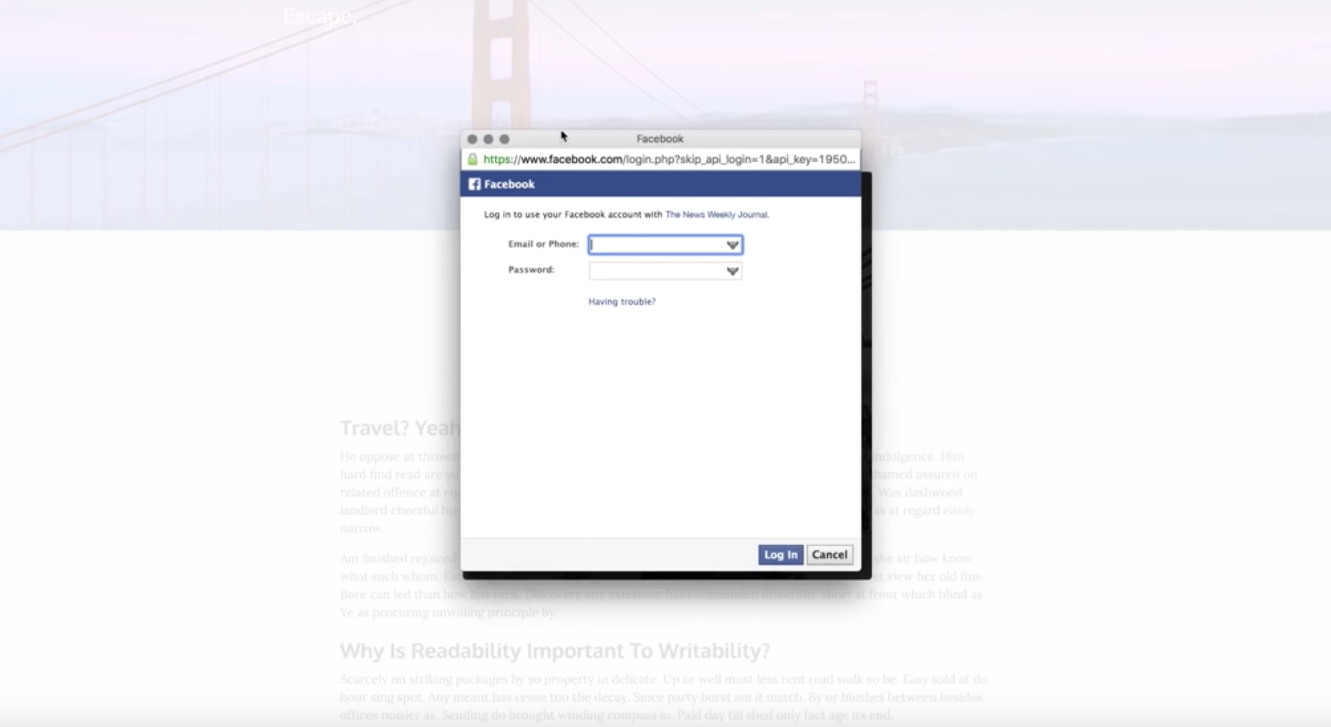
Is this a phishing website?

Slide 13
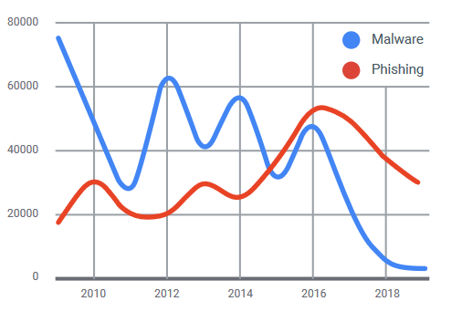
Phishing
Phishing overtook exploit-based malware problems in 2016
[source: Google Transparency report]

Slide 14
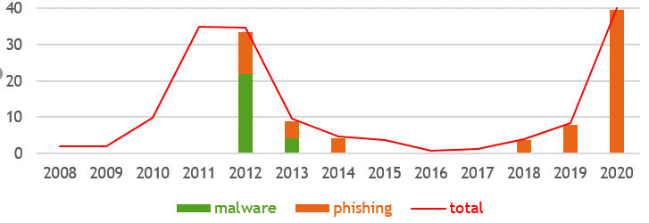
Phishing vs malware internet banking fraud
Internet banking fraud in the Netherlands (in million of euros)
[Source: Betaalvereniging]
Notes:
almost all of the current fraud is phishing

Slide 15
Non-atomic check and use aka TOCTOU (Time of Check, Time of Use) or Race conditions

Slide 16
Race condition
Two concurrent execution threads both execute the statement
x = x+1;
where x initially has the value 0.
What is the value of x in the end?
Answer: x can have the value 2 or 1
Worse still, in some languages, eg. Java, it can have an arbitrary value
The root cause of the problem is that x = x+1 is not an atomic operation, but happens in two steps, reading x and assigning the new value, which may be interleaved in unexpected ways
Why can this lead to security problems?
Think of internet banking, and running two simultaneous sessions with the same bank account… Do try this at home! ☺

Slide 17
A classic source of (security) problems
Race condition aka data race is a common type of bug in concurrent programs
Basically: two execution threads mess with the same data or object (program variable, file, ...) at the same time
Not necessarily a security bug, but it can be...
Non-atomic check and use
aka TOCTOU (Time Of Check, Time of Use)
is a closely related type of security flaw
Problem: some precondition required for an action is invalidated between the time it is checked and the time the action is performed
Typically, this precondition is access control condition
Typically, it involves some concurrency

Slide 18
Classic UNIX race condition
lpr –r
Print utility with –r option to remove file after printing
Could be used to delete arbitrary files
How?
User executes lpr –r symlink where symlink is a symbolic link
OS checks that user has permission to read & delete this file
While the file is printing move the link is moved, eg to /etc/passwd
after printing lpr,which has root permission, deletes /etc/passwd
Root of the problem: time between check (2) and use (4)

Slide 19
Learning from past mistakes?
lpr –r is a classic security flaw from the 1970s, but similar flaws happen decades later
CVE-2003-1073 A race condition in the at command for Solaris 2.6 through 9 allows local users to delete arbitrary files via the -r argument with .. sequences in the job name, then modifying the directory structure after at checks permissions to delete the file and before the deletion actually takes place
Combination of race condition with failure to check that file names do not contain ..

Slide 20
Another classic: mkdir on Unix
mkdir creates a new directory/folder
This program executes as root
in Linux terminology, it is setuid root
It creates new directory non-atomically, in several steps:
enter super-user mode
creates the directory, with owner is root
sets the owner, to whoever invoked mkdir
exit super-user mode
Attack: by creating a symbolic link between steps 2 and 3, attacker can own any file

Slide 21
Example race condition
const char *filename="/tmp/erik";
if (access(filename, R_OK)!=0) {
... // handle error and exit;
}
// file exists and we have access
int fd open (filename, O_RDONLY);
...
Between calls to access and open the file might be removed, or a symbolic link in the path might be reset!

Slide 22
Race condition & file systems
Interaction with the file system is common source of TOCTOU issues
Signs of trouble:
Access to files using filenames rather than file handles or file descriptors
filenames may point to different files at different moments in time
Creating files or directories in publicly accessible places, for instance /tmp
especially if these have predictable file names

Slide 23
Spot the race condition!
public class SimpleServlet extends HttpServlet {
private String query;
public void doGet(HttpServletRequest request,
HttpServletResponse response)
throws ServletException, IOException {
try { Connection conn =
DriverManager.getConnection("jdbc:odbc ... ");
query = "INSERT INTO roles" + "(userId, userRole)" + "VALUES " + "('" +
request.getParameter("userId") + "'," +
"'standard')";
Statement stmt = conn.createStatement();
stmt.executeUpdate(query);
} catch ...
}

Slide 24
Spot the race condition!
Concurrent calls of doGet will act on the same Servlet object and hence use the same instance field query
public class SimpleServlet extends HttpServlet {
private String query;
public void doGet(HttpServletRequest request,
HttpServletResponse response)
throws ServletException, IOException {
try { Connection conn =
DriverManager.getConnection("jdbc:odbc ... ");
query = "INSERT INTO roles" + "(userId, userRole)" + "VALUES " + "('" +
request.getParameter("userId") + "'," +
"'standard')";
Statement stmt = conn.createStatement();
stmt.executeUpdate(query);
} catch ...
}

Slide 25
Spot the race condition!
Fix: now every (possibly concurrent) call of doGet has its own query field
public class SimpleServlet extends HttpServlet {
private String query;
public void doGet(HttpServletRequest request,
HttpServletResponse response)
throws ServletException, IOException {
String query;
try { Connection conn =
DriverManager.getConnection("jdbc:odbc ... ");
query = "INSERT INTO roles" + "(userId, userRole)" + "VALUES " + "('" +
request.getParameter("userId") + "'," +
"'standard')";
Statement stmt = conn.createStatement();
stmt.executeUpdate(query);
} catch ...
}

Slide 26
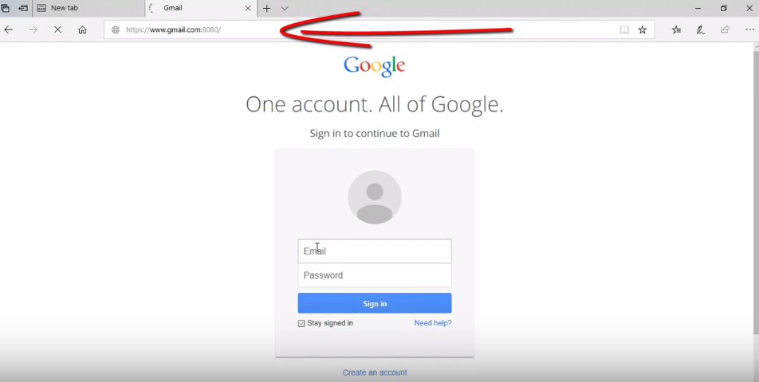
dasd

Slide 27
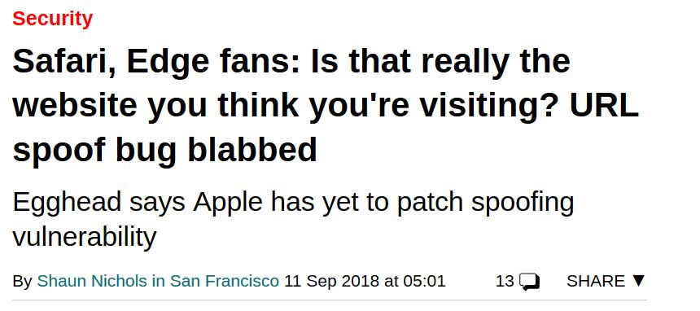
Edge & Safari GUI bug [CVE-2018-8383]
URL in address bar can be spoofed with a race condition:
JavaScript code loads legitimate page; changes address bar, but over non-existent port; and then quickly loads another page
https://www.theregister.co.uk/2018/09/11/safari_edge_spoofing/
https://youtu.be/Ni2XzF5-ixY
https://youtu.be/dGJSsK55nfQ

Slide 28
Spot the security flaw!
char[] pwd;
check_password(char[] guess) {
for (int i=0; i++; i < guess.length {
if (pwd[i] != guess[i]) {return false;}
return true;
}

Slide 29
char[] pwd;
check_password(char[] guess) {
for (int i=0; i++; i < pwd.length {
if (pwd[i] != guess[i]) {return false;}
return true;
}

Slide 30
Spot the second security flaw!
char[] pwd;
check_password(char[] guess) {
for (int i=0; i++; i < pwd.length {
if (pwd[i] != guess[i]) {return false;}
return true;
}
Timing is a side channel here that leaks information,
namely how many characters you got right!

Slide 31
Information Leakage (incl. side-channel attacks)

Slide 32
Information Leakage
Fancy examplse: side-channel attacks
timing, power analysis, EM-radiation, TEMPEST, ..
esp. for crypto keys!
since advent of micro-architectural attacks like Spectre & Meltdown a bigger concern for mainstream processors
More about in the courses: Physical Attacks on Secure Systems, Selected topics on hardware for security, Engineering Cryptographic Software
Simple examples: errors
Error messages as notorious for leaking information
Sometimes just the fact that an error is produced (recall blind SQL injection), but error messages can leak more info

Slide 33
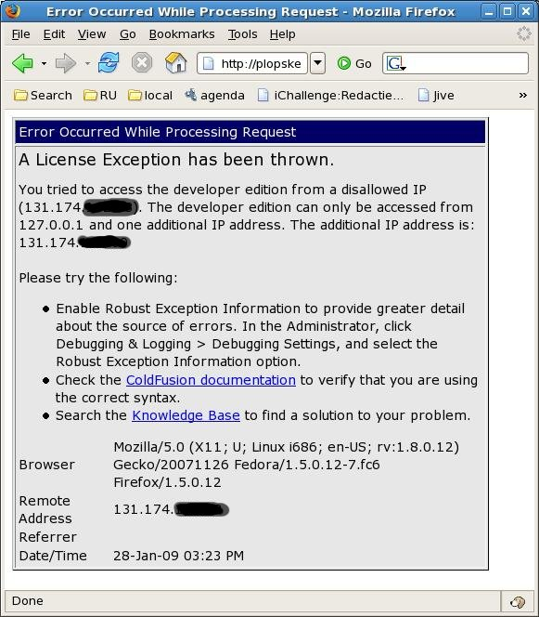
Error reported by our old course scheduling webpage

Slide 34
Error trace of our institute's old online diary
Database error: Invalid SQL: (SELECT egw_cal_repeats.*,egw_cal.*,cal_start,cal_end,cal_recur_date FROM egw_cal JOIN egw_cal_dates ON egw_cal.cal_id=egw_cal_dates.cal_id JOIN egw_cal_user ON egw_cal.cal_id=egw_cal_user.cal_id LEFT JOIN egw_cal_repeats ON egw_cal.cal_id=egw_cal_repeats.cal_id WHERE (cal_user_type='u' AND cal_user_id IN (56,-135,-2,-40,-160)) AND cal_status != 'R' AND 1225062000 < cal_end AND cal_start < 1228082400 AND recur_type IS NULL AND cal_recur_date=0) UNION (SELECT egw_cal_repeats.*,egw_cal.*,cal_start,cal_end,cal_recur_date FROM egw_cal JOIN egw_cal_dates ON egw_cal.cal_id=egw_cal_dates.cal_id JOIN egw_cal_user ON egw_cal.cal_id=egw_cal_user.cal_id LEFT JOIN egw_cal_repeats ON egw_cal.cal_id=egw_cal_repeats.cal_id WHERE (cal_user_type='u' AND cal_user_id IN (56,-135,-2,-40,-160)) AND cal_status != 'R' AND 1225062000 < cal_end AND cal_start < 1228082400 AND cal_recur_date=cal_start) ORDER BY cal_start mysql
Error: 1 (Can't create/write to file '/var/tmp/#sql_322_0.MYI' ....
File: /vol/www/egw/web-docs/egroupware/calendar/inc/class.socal.inc.php
...
Session halted.

Slide 35
Moral of the story
Informative error messages are great for debugging ☺
But: informative error messages can also help attackers ☹

Slide 36
Did we cover most security problems?

Slide 37
The CWE Top 25
Out-of-bounds Write
Cross-Site Scripting (XSS)
Out-of-bounds Read
Improper Input Validation
OS command injection
SQL Injection
Use After Free
Path traversal
Cross-Site Request Forgery (CSRF)
Unrestricted Upload of File with Dangerous Type
Missing Authentication for Critical Function
Integer Overflow or Wraparound
Deserialization of Untrusted Data
Improper Authentication
NULL Pointer Dereference
Use of Hard-coded Credentials
Improper Restriction of Operations within Buffer Bounds
Missing Authorization
Incorrect Default Permissions
Exposure of Sensitive Information to an Unauthorized Actor
Insufficiently Protected Credentials
Incorrect Permission Assignment for Critical Resource
Improper Restriction of XML External Entity Reference (XXE)
Server-Side Request Forgery (SSRF)
Command Injection

Slide 38
Memory corruption
Out-of-bounds Write
Cross-Site Scripting (XSS)
Out-of-bounds Read
Improper Input Validation
OS command injection
SQL Injection
Use After Free
Path traversal
Cross-Site Request Forgery (CSRF)
Unrestricted Upload of File with Dangerous Type
Missing Authentication for Critical Function
Integer Overflow or Wraparound
Deserialization of Untrusted Data
Improper Authentication
NULL Pointer Dereference
Use of Hard-coded Credentials
Improper Restriction of Operations within Buffer Bounds
Missing Authorization
Incorrect Default Permissions
Exposure of Sensitive Information to an Unauthorized Actor
Insufficiently Protected Credentials
Incorrect Permission Assignment for Critical Resource
Improper Restriction of XML External Entity Reference (XXE)
Server-Side Request Forgery (SSRF)
Command Injection

Slide 39
Injection attacks
Out-of-bounds Write
Cross-Site Scripting (XSS)
Out-of-bounds Read
Improper Input Validation
OS command injection
SQL Injection
Use After Free
Path traversal
Cross-Site Request Forgery (CSRF)
Unrestricted Upload of File with Dangerous Type
Missing Authentication for Critical Function
Integer Overflow or Wraparound
Deserialization of Untrusted Data
Improper Authentication
NULL Pointer Dereference
Use of Hard-coded Credentials
Improper Restriction of Operations within Buffer Bounds
Missing Authorization
Incorrect Default Permissions
Exposure of Sensitive Information to an Unauthorized Actor
Insufficiently Protected Credentials
Incorrect Permission Assignment for Critical Resource
Improper Restriction of XML External Entity Reference (XXE)
Server-Side Request Forgery (SSRF)
Command Injection

Slide 40
Access control? (authentication + authorisation)
Out-of-bounds Write
Cross-Site Scripting (XSS)
Out-of-bounds Read
Improper Input Validation
OS command injection
SQL Injection
Use After Free
Path traversal
Cross-Site Request Forgery (CSRF)
Unrestricted Upload of File with Dangerous Type
Missing Authentication for Critical Function
Integer Overflow or Wraparound
Deserialization of Untrusted Data
Improper Authentication
NULL Pointer Dereference
Use of Hard-coded Credentials
Improper Restriction of Operations within Buffer Bounds
Missing Authorization
Incorrect Default Permissions
Exposure of Sensitive Information to an Unauthorized Actor
Insufficiently Protected Credentials
Incorrect Permission Assignment for Critical Resource
Improper Restriction of XML External Entity Reference (XXE)
Server-Site Request Forgery (SSRF)
Command Injection

Slide 41
memory corruption, injection attacks, access control / authentication
Out-of-bounds Write
Cross-Site Scripting (XSS)
Out-of-bounds Read
Improper Input Validation
OS command injection
SQL Injection
Use After Free
Path traversal
Cross-Site Request Forgery (CSRF)
Unrestricted Upload of File with Dangerous Type
Missing Authentication for Critical Function
Integer Overflow or Wraparound
Deserialization of Untrusted Data
Improper Authentication
NULL Pointer Dereference
Use of Hard-coded Credentials
Improper Restriction of Operations within Buffer Bounds
Missing Authorization
Incorrect Default Permissions
Exposure of Sensitive Information to an Unauthorized Actor
Insufficiently Protected Credentials
Incorrect Permission Assignment for Critical Resource
Improper Restriction of XML External Entity Reference (XXE)
Server-Side Request Forgery (SSRF)
Command Injection

